Slide 1
Church Board Training

Slide 2
Church Organization
The Seventh-day Adventist Church is a worldwide movement with over 20,000,000 members
There is only one Seventh-day Adventist Church in the world.

Slide 3
Local Church
A local church is a body of believers in a particular location who meet together for worship and service. This group of members must be granted, by the constituency of a conference in session, official status as a church.

Slide 4
Local Conference
A local conference/Mission is a group of local churches within a defined geographic area, that has been granted conference status.
All the local churches in St Kitts, Nevis, Montserrat, Barbuda and Antigua come together to form South Leeward Conference.

Slide 5
Union Conferences
A union is a grouping of local conferences within a larger geographic area that has been granted Union status. In some instances, a group of churches may be granted status as a Union of Churches.

Slide 6
In the Caribbean area, local conferences and Missions come together to form the Caribbean Union. There are 10 conferences and Missions in the Caribbean:
Suriname Mission, Guyana Conference, South Caribbean Conference, Tobago Mission, Grenada Conference. St Vincent and the Grenadines Mission, St Lucia Mission, East Caribbean Conference, South Leeward Conference and North Caribbean Conference.

Slide 7
General Conference
The general conference is the grouping of all Unions. The General Conference is divided into 13 Divisions, attached fields and Union Missions.

Slide 8
The Inter-American Division
The Inter-American Division (IAD) is comprised of Mexico, the Caribbean, Central America and the five northernmost countries in South America—Colombia, Venezuela, Guyana, Suriname and French Guiana.
In all, there are 42 countries. The Division has 24 Unions and over 22,000 churches.

Slide 9
•
Local Church

Slide 10
Local Conference

Slide 11
Union

Slide 12
General Conference

Slide 13
General Conference
Divisions

Slide 14
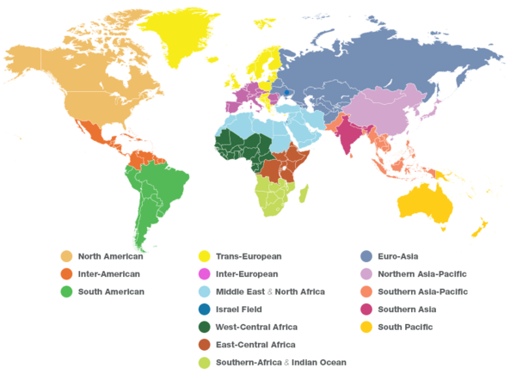

Slide 15
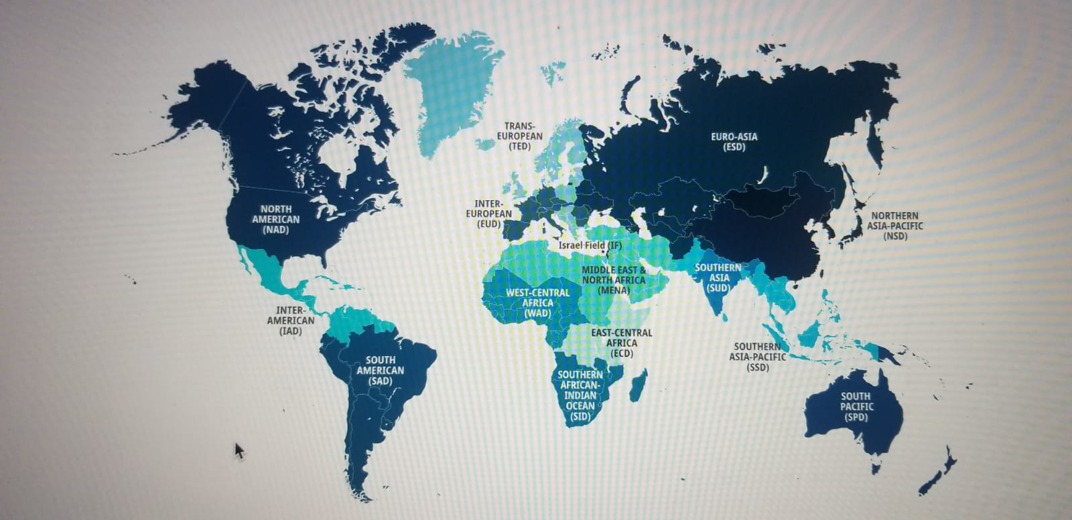

Slide 16
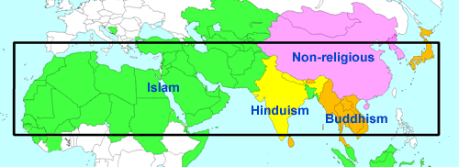
The 10/40 Window

Slide 18
Why Organization?
Just as there can be no living, active human body unless its members are organically united and functioning together, so there can be no living, growing, prospering church unless its members are organized into a united spiritual body, all performing their God-given duties and functions under the direction of a divinely constituted authority.

Slide 19
Without organization each congregation would be left to do its own thing.
Organization helps the church to function as a united body.
To facilitate this, the church has established guidelines and principles based on the Bible and documented in a manual.

Slide 20
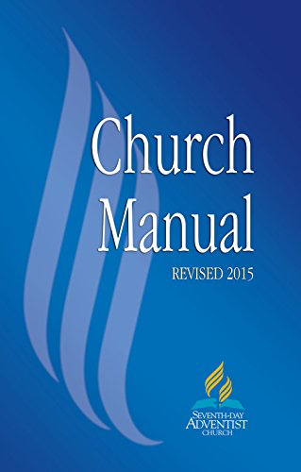
The Church Manual

Slide 21
Why does the Seventh-day Adventist Church have a Church Manual?
God is a God of order as evidenced in His works of creation and redemption. Consequently, order belongs to the essence of His church. Order is achieved through principles and regulations that guide the Church in its internal operations and in the fulfillment of its mission to the world.

Slide 22
In order for it to be a successful ecclesiastical organization at the service of the Lord and humanity, it needs order, rule, and discipline. Scripture affirms that all things be done decently and in order (1 Cor 14:40).

Slide 23
While the church initially declined to adopt a manual, it became clear that without one, it would be impossible to maintain unity and so in the 1931 General Conference delegates voted to publish one.

Slide 24
The opening sentence of the preface of that first edition observed that “it has become increasingly evident that a manual on church government is needed to set forth and preserve our denominational practices and polity.”

Slide 25
The Church Manual has existed in its current format since 1932. It describes the operation and functions of local churches and their relationship to denominational structures in which they hold membership.

Slide 26
The Church Manual also expresses the Church’s understanding of Christian life and church governance and discipline based on biblical principles and the authority of duly assembled General Conference Sessions.

Slide 27
“God has ordained that the representatives of His church from all parts of the earth, when assembled in a General Conference, shall have authority.”—9T 261

Slide 28
The Church Manual is divided into two types of material. The content of each chapter is of worldwide value and is applicable to every church organization, congregation, and member.

Slide 29
Recognizing the need for variations in some sections, additional explanatory material, presented as guidance and examples, appears as notes at the end of the Church Manual. The notes have subheadings corresponding to chapter subheadings and page numbers of the main text.

Slide 30
The standards and practices of the Church are based upon the principles of the Holy Scriptures. These principles, underscored by the Spirit of Prophecy, are set forth in this Church Manual. They are to be followed in all matters pertaining to the administration and operation of local churches.

Slide 31
The Church Manual also defines the relationship that exists between the local congregation and the conference or other entities of Seventh-day Adventist denominational organization.

Slide 32
No attempt should be made to set up standards of membership or to make, or attempt to enforce, rules or regulations for local church operations that are contrary to these decisions adopted by the General Conference in Session and that are set forth in this Church Manual. (pages 16 and 17).

Slide 33
Church Board Function

Slide 34
The church board is the governing body of the local congregation.
It is composed of the principal officers of the church
Your function as a board member supersedes that of your departmental responsibility.

Slide 35
Definition and Function—Every church must have a functioning board whose members have been elected during a church business meeting. Its chief concern is having an active discipleship plan in place, which includes both the spiritual nurture of the church and the work of planning and fostering evangelism.*
Church Manual @2016 p 129

Slide 36
Included in church board responsibilities are:
An active discipleship plan.
Evangelism in all of its phases.
Spiritual nurturing and mentoring of members.
Maintenance of doctrinal purity.

Slide 37
Upholding of Christian standards.
Recommending changes in church membership.
Oversight of church finances.
Protection and care of church properties.
Coordination of church departments.

Slide 38
The Chairperson
The chairperson of the board is the conference-appointed pastor.

Slide 39
Meeting Time: Because the work of the board is vital to the life, health, and growth of the church, it is recommended that it meets at least once each month, more frequently if needed. It is well to fix the monthly meeting time for the same week and the same day each month. (p131)

Slide 40
The Work of the Board
The board should permit no other business to interfere with planning for evangelism. (p132)

Slide 41
The Work of the Board
The board is responsible to: 1. Ensure that there is an active, ongoing discipleship plan in place, which includes both spiritual nurture and outreach ministries. This is the most important item for the board’s attention.

Slide 42
Study membership lists and initiate plans for reconnecting (reclaiming) members who have separated from the church.
Train local church leadership in how to encourage intentional spiritual growth in themselves and others.

Slide 43
Evangelize the outreach (missionary) territory of the church.
Coordinate outreach programs for all church departments, although each department develops its plans for outreach within its own sphere.
Encourage the personal ministries department to enlist all members and children in some form of personal outreach (missionary) service.

Slide 44
Encourage the interest coordinator to ensure that every interest is personally and promptly followed up by assigned laypersons.
Encourage each department to report at least quarterly to the board and to members at business meetings or in Sabbath meetings in regards to spiritual nurture and evangelism.

Slide 45
Receive regular reports.
Promote Adventist education.

Slide 46
Matters of Governance
Respect for Authority:
As Creator, Redeemer and Sustainer, Lord and King of all creation, God alone is the source of authority for the Church. He delegated authority to His prophets and apostles (2 Cor. 10:8). They, therefore, occupied a crucial and unique position in the transmission of the Word of God and the edification of the church (Eph. 2:20). p29

Slide 47
“God has a church, and she has a divinely appointed ministry. ‘And He gave some, apostles; and some, prophets; and some, evangelists; and some, pastors and teachers; for the perfecting of the saints, for the work of the ministry, for the edifying of the body of Christ: till we all come in the unity of the faith, and of the knowledge of the Son of God, unto a perfect man, unto the measure of the stature of the fullness of Christ. . . . ’ p 31

Slide 48
“Men appointed of God have been chosen to watch with jealous care, with vigilant perseverance, that the church may not be overthrown by the evil devices of Satan, but that she shall stand in the world to promote the glory of God among men.”—TM 52, 53.

Slide 49
The conference president should be an ordained pastor of experience and good report. He stands at the head of the gospel ministry in the conference and is the chief elder, or overseer, of all the churches. He works for their spiritual welfare and counsels them regarding their activities and plans.

Slide 50
He has access to all the churches and their services, business meetings, and boards, without vote unless granted by the church, or unless he is a member of that congregation. He may, by virtue of his office, preside over any meeting of any church when necessary. He has access to all church records. P 31

Slide 51
The conference president does not have authority to set aside the duly elected officers of the church but will work in cooperation with them. They in turn are bound, in recognition of the ties of conference fellowship, to counsel with him over all that pertains to the welfare of the church. They should not attempt to exclude him from a proper discharge of his duties.

Slide 52
Conference departmental directors foster important lines of denominational work under the general direction of the conference committee in consultation with the conference president.
Departmental directors are not vested with administrative or executive authority, so their relation to local churches is advisory.

Slide 53
The pastor should be the congregation’s spiritual leader and adviser. Pastors should instruct the officers in their duties and plan with them for all lines of church work and activity.
The pastor is a member of the church board and serves as its chairperson.

Slide 54
Pastors or assistant pastors are not nominated or elected to such positions by the church. Their connection with the church is by appointment of the conference committee, and such appointments may be changed at any time.

Slide 55
If the conference committee assigns a pastor or pastors to the congregation, the pastor, or senior pastor if more than one, should be considered the ranking officer and the local elders as assistants. Since their work is closely related, they should work together harmoniously. pp 73,74

Slide 56
Protocol
As the spiritual leader of the church, the pastor must be informed of all activities. He or she is responsible for all that happens in that congregation.
The church must not make decisions without the Pastor’s knowledge
The elder must not call a board meeting without the pastor’s knowledge or permission.

Slide 57
Inviting others to speak in the church/pulpit
Respect the authority of the Pastor and Board
Respect the authority of the church from which the person is coming
Departmental Activities
Get board approval
Ensure that appropriate security measures are in place such as insurance coverage for camps and other such activities etc.

Slide 58
Risk Management
Guarding against litigation
Have adequate coverage against physical damage
The role of the safety officer
Fiscal Responsibility
Church budget and stewardship
Reporting to the board

Slide 59
Discipline
The Bible and the Spirit of Prophecy set forth in clear, unmistakable language the solemn responsibility that rests upon the people of God to maintain their purity, integrity, and spiritual fervor. If members grow indifferent or drift away, the church must seek to reclaim them for the Lord. P 56

Slide 60
Church’s Responsibility—“God holds His people, as a body, responsible for the sins existing in individuals among them. If the leaders of the church neglect to diligently search out the sins which bring the displeasure of God upon the body, they become responsible for these sins.”—3T 269.
“If there were no church discipline and government, the church would go to fragments; it could not hold together as a body.”—3T 428. (p 58)

Slide 61
“No church officer should advise, no committee should recommend, nor should any church vote, that the name of a wrongdoer shall be removed from the church books, until the instruction given by Christ has been faithfully followed. When this instruction has been followed, the church has cleared herself before God.

Slide 62
An Effective Church Board:
Is evangelistically oriented
Does not mistake movement for mission or activity for achievement
Is proactive

Slide 63
Has a clear sense of tomorrow
Is willing to ask some tough questions and search out the answers
Is willing to take some risks
Is biblically informed and socially aware

Slide 64
Has a clear vision of where the church is going and how it will get there.

Slide 65
Evangelistic Focus
As the Church Manual states, the chief responsibility of the Board is to foster an active discipleship plan for the congregation.

Slide 66
Evangelistic Focus
It is important to note that this involves both nurture and evangelism.
Nurture- in reach- New believers and present members.
Evangelism- outreach –evangelistic and missionary activities .

Slide 67
Discipleship Plan
The Discipleship Plan should focus on:
The spiritual nurture of every member
Personal witnessing /Evangelism
Retention of present members
Reclamation of missing and former members
Participation of adults, children, youth, and young adults in the work of the Church. (Spiritual gifts)

Slide 68
Discipleship Plan
Since the board is responsible for the development of a meaningful discipleship plan, the board is also responsible to see that such a plan is carefully carried out.

Slide 69
Youth Ministry and Evangelism
Over the years, we have had complaints from various sectors of the Youth department that the evangelistic program of the church negatively affects the ministry to the youths—Pathfinder, Adventurer or Adventist Youth.

Slide 70
Youth Ministry and Evangelism
To begin with, the departments are not separate entities. Like the various parts of the human body, they are to function together to make the body achieve its goals in a meaningful way.

Slide 71
Youth Ministry and Evangelism
Adventurer and Pathfinder clubs follow a specific curriculum, but they do not function independent of the church or larger organization.

Slide 72
Youth Ministry and Evangelism
When the church develops its calendar of events, it should take into consideration the various departments and factor in how they can best facilitate the overall mission of the church.

Slide 73
Youth Ministry and Evangelism
Evangelism is the church’s business. This is an important element of Youth Ministry.

Slide 74
Youth Ministry and Evangelism
When the board plans an evangelistic campaign, every department is to be involved.
The youth should actively participate in the campaign.
The youth should be taught to embrace evangelism and mission.

Slide 75
The Pathfinder Curriculum
The Pathfinder handbook provides for two or three options ranging from 20 to 30 weeks duration for the successful completion of the Pathfinder Course Work.

Slide 76
The Pathfinder Director and the Church Board
The Pathfinder Director is to work with the Church Board to ensure that the schedule of classes are properly coordinated with the rest of the church’s programme.

Slide 77
The Pathfinder Director and the Church Board
It is important to note that directors are accountable to the board although they work in conjunction with the Conference Director and area coordinators.

