Slide 1
Public Affairs & Church-State Relations: How Involved Should the Church be?
Anthony Hall
Vice President CARLA/Attorney-at-law
CARIBBEAN
RELIGIOUS LIBERTY ASSOCIATION

Slide 2
Understanding
Separation of church and state
It’s Not a Biblical term
Its not a Constitutional term
CARIBBEAN
RELIGIOUS LIBERTY ASSOCIATION

Slide 3
Understanding
Separation of church and state
In the OT, there was fusion of political and religious polity. Although, in the religious and political aspect of Israel’s society, there were separation of power and functions between the King, priest/prophet, there was no separation between the monarchical system of government and the monotheistic religion of Israel.
CARIBBEAN
RELIGIOUS LIBERTY ASSOCIATION

Slide 4
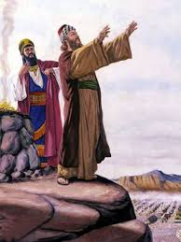
Understanding
Separation of church and state
While the King was saddled with the responsibility of political governance, the priest/prophet was saddled with the responsibility of guiding the king with the instructions of Yaweh.
CARIBBEAN
RELIGIOUS LIBERTY ASSOCIATION

Slide 5
Understanding
Separation of church and state
When God’s people left Egypt, God had them establish their own nation. At that time, God placed Moses over government and civil affairs (Judge)and Aaron (the Priest) over spiritual ones, thus separating those two roles and jurisdictions. Neither excluded God from its operation, but each was to be headed and run by a different individual and not the same person.
CARIBBEAN
RELIGIOUS LIBERTY ASSOCIATION

Slide 6
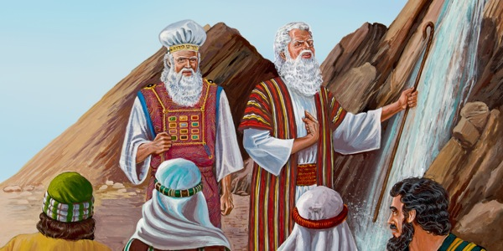

Slide 7
Understanding
Separation of church and state
King Uzziah is struck with leprosy because he offered incense in the temple without a priest. (2 Chron. 26:16-23).
Uzziah did not recognize the kind of church/state relationship envisioned in the law, and God struck him with leprosy.
CARIBBEAN
RELIGIOUS LIBERTY ASSOCIATION

Slide 8
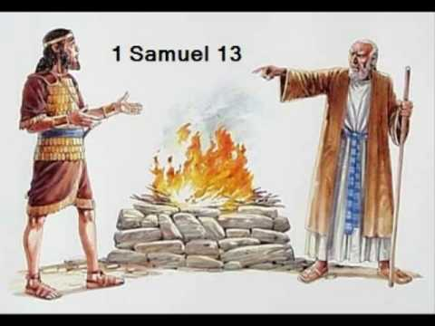
Understanding
Separation of church and state
1 Samuel 13, Saul offered burnt offerings and peace offerings at Gilgal (v. 8-10). Saul offers a pragmatic argument for why he did so (v. 11); the people were scattering and the Phillistines were mustering and something had to be done.
CARIBBEAN
RELIGIOUS LIBERTY ASSOCIATION

Slide 9
Understanding
Separation of church and state
Samuel makes clear that what Saul did was wrong (v. 13) and as a result of this action Saul’s kingdom would not continue, because Saul disobeyed the commandments (v. 14). … he mixed the functions which should be separate.
CARIBBEAN
RELIGIOUS LIBERTY ASSOCIATION

Slide 10
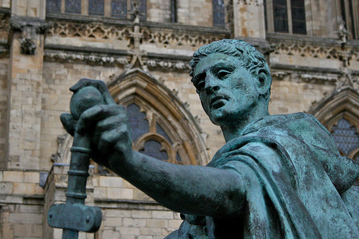
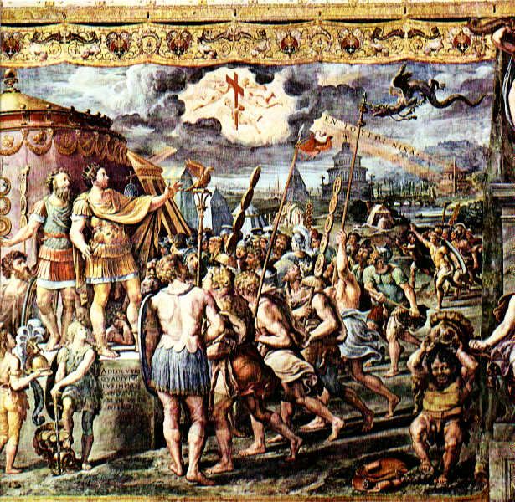
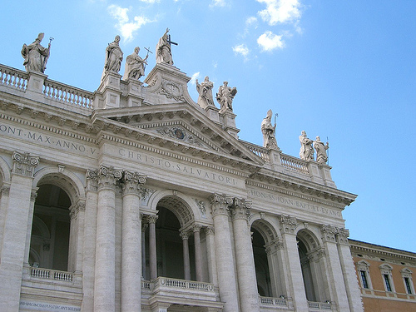
THE TRIUMPH OF THE CROSS
313 Edict of Milan
Christianity enjoyed the status of “religio licita” – “an approved Religion”
No more crucifixions
Christians were given places for worship
In 391, Emperor Theodosius the Great declared Christianity as the state religion of Rome, and the only legitimate imperial religion.

Slide 11
Understanding
Separation of church and state
In 391 AD, Emperor Theodosius combined both Church and State, and for the next twelve centuries, the State was in charge of the Church. The government decided what the official Church doctrines would be, and it punished violators who disagreed with those positions, not allowing them to practice their faith.
CARIBBEAN
RELIGIOUS LIBERTY ASSOCIATION

Slide 12
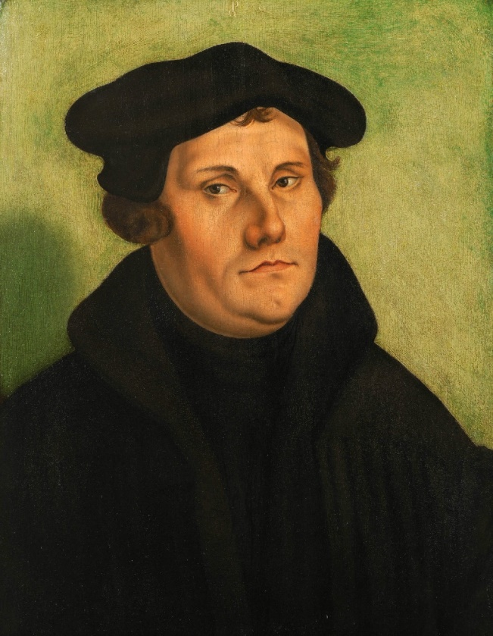
Understanding
Separation of church and state
In the 1500’s during the Reformation, those who followed the Bible began to call for a return to a Biblical separation of Church and State so that the government would no longer control or prohibit religious activities.
CARIBBEAN
RELIGIOUS LIBERTY ASSOCIATION

Slide 13
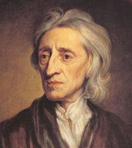
Understanding
Separation of church and state
English philosopher John Locke’s A Letter Concerning Toleration, penned in 1689, outlined how to “distinguish exactly the business of civil government from that of religion.”
CARIBBEAN
RELIGIOUS LIBERTY ASSOCIATION

Slide 14
Understanding
Separation of church and state
According to Locke, the government and the church are “perfectly distinct and infinitely different” entities with differing interests. In other words, the state is concerned with the “civil rights and worldly goods” but cannot in practice command conscience, and therefore cannot command the spiritual good of society.
CARIBBEAN
RELIGIOUS LIBERTY ASSOCIATION

Slide 15
Understanding
Separation of church and state
John Locke in A Letter Concerning Toleration, suggested that the civil magistrate is not to be concerned with sin* as such; 1.only with the public good, ‘the Rule and Measure of all Law-making’.2 According to Locke, ‘the Care of Souls does not belong to the Magistrate’.3 This is rather the sole aim of the Church.
CARIBBEAN
RELIGIOUS LIBERTY ASSOCIATION

Slide 16
Understanding
Separation of church and state
Thomas Jefferson adopted Locke’s ideas:
“Our rulers can have authority over our natural rights only as we have submitted to them. The rights of conscience we never submitted, we could not submit. We are answerable for them to our God. The legitimate powers of government extend to such acts only as are injurious to others.” Thomas Jefferson, _Notes on the State of Virginia_ (Digital Facsimile of the manuscript copy of 1785 edition, Massachusetts Historical Society) 95.
CARIBBEAN
RELIGIOUS LIBERTY ASSOCIATION

Slide 17
Understanding
Separation of church and state
Related to government, the phrase first appeared in a letter written by Thomas Jefferson to the Danbury Baptist Association of Connecticut in 1801.
CARIBBEAN
RELIGIOUS LIBERTY ASSOCIATION

Slide 18
Understanding
Separation of church and state
Thomas Jefferson had worked very hard to separate the Anglican Church from the government in his home state of Virginia so that all other denominations could practice their faith without government penalty or persecution so, when he became president of the United States, he had the same idea.
CARIBBEAN
RELIGIOUS LIBERTY ASSOCIATION

Slide 19
Understanding
Separation of church and state
The Danbury Baptists wrote Thomas Jefferson expressing their concern that the government might try to regulate their religious expression. In response, Jefferson wrote his now famous letter, using the phrase “Separation of Church and State” to reassure the Danbury Baptists that the First Amendment prohibited the government from trying to control religious expression.
CARIBBEAN
RELIGIOUS LIBERTY ASSOCIATION

Slide 20
Understanding
Separation of church and state
In short, the First Amendment was intended to keep government out of regulating religion, but it did not seek to keep religion out of government or the public square.*
CARIBBEAN
RELIGIOUS LIBERTY ASSOCIATION

Slide 21
Congress shall make no law respecting an establishment of religion, or prohibiting the free exercise thereof.
United States Constitution, Bill of Rights Amendment 1.
CARIBBEAN
RELIGIOUS LIBERTY ASSOCIATION

Slide 22
#1: Law Should not Compel Religion
#2 Law Should not Exclude Religion
CARIBBEAN
RELIGIOUS LIBERTY ASSOCIATION

Slide 23
Luke 9:49-50
Then he said to them, “Therefore render to Caesar the things that are Caesar’s, and to God the things that are God’s” (Matt. 22:20–21).

Slide 24
Romans 13: 1-4
Let every soul be subject unto the higher powers. For there is no power but of God: the powers that be are ordained of God.

Slide 25
Romans 13: 1-4
² Whosoever therefore resisteth the power, resisteth the ordinance of God: and they that resist shall receive to themselves damnation.

Slide 26
Romans 13: 1-4
³ For rulers are not a terror to good works, but to the evil. Wilt thou then not be afraid of the power? do that which is good, and thou shalt have praise of the same:

Slide 27
Romans 13: 1-4
⁴ For he is the minister of God to thee for good. But if thou do that which is evil, be afraid; for he beareth not the sword in vain: for he is the minister of God, a revenger to execute wrath upon him that doeth evil.

Slide 28
Acts 5:29
But Peter and the apostles answered, “We must obey God rather than men. ESV

Slide 29
1 Peter 2:13-15, 17
Submit yourselves to every ordinance of man for the lord’s sake: whether it be to the king, as supreme; or unto governors, as unto them that are sent by him for the punishment of evildoers, and for the praise of them that do well.

Slide 30
1 Peter 2:13-15, 17
For so is the will of God, that with well doing you may put to silence the ignorance of foolish men…Honor all men. Love the brotherhood. Fear God. Honor the king

Slide 31
1 Timothy 2:1-2
I exhort therefore, that, first of all, supplications, prayers, intercessions, and giving of thanks, be made for all men; ² For kings, and for all that are in authority; that we may lead a quiet and peaceable life in all godliness and honesty.

Slide 32
Proverbs 31:8-9
⁸ Open thy mouth for the dumb in the cause of all such as are appointed to destruction. Open thy mouth, judge righteously, and plead the cause of the poor and needy

Slide 33
The PARL Department
represents the Church before governments, international organizations, and other religions, maintaining good relationships.
monitors and interprets current events that may reflect on prophetic scenarios.
promotes and maintains religious freedom around the world
assists members of the SDA Church who are discriminated against or persecuted for practicing their beliefs.
CARIBBEAN
RELIGIOUS LIBERTY ASSOCIATION

Slide 34
PARL works to position the Seventh-day Adventist Church and its services to a standing of credibility, trust, and relevance in the public realm.
Why? So the Adventist Church can be more effective in its mission. Our task is to enhance our church's ability to operate around the world by building bridges with public and religious leaders.
CARIBBEAN
RELIGIOUS LIBERTY ASSOCIATION

Slide 35
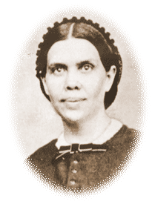
“It is our duty to do all in our power to avert the threatened danger. We should endeavor to disarm prejudice by placing ourselves in a proper light before the people. We should bring before them the real question at issue, thus interposing the most effectual protest against measures to restrict liberty of conscience.” 5T, p. 452
CARIBBEAN
RELIGIOUS LIBERTY ASSOCIATION

Slide 36
Diplomacy
PARL maintains a presence at the United Nations in New York and Geneva, and with other international organizations. We also have an office on Capitol Hill in Washington, DC, where we maintain contact with lawmakers, the White House, and members of Washington's large and diverse diplomatic community. We build relationships with state leaders and public officials by visiting with them, and by inviting some to visit with Adventist Church leaders at various meetings and events.
CARIBBEAN
RELIGIOUS LIBERTY ASSOCIATION

Slide 37
Religious Liberty Litigation
In various countries it may become necessary from time to time to take legal action in defense of the religious liberty rights of church organizations or individuals, including the right of Sabbath observance. However, before resorting to the courts, every effort should be made to settle matters equitably in support of free exercise of religion.
CARIBBEAN
RELIGIOUS LIBERTY ASSOCIATION

Slide 38
In this effort, we adhere to three general principles:
1. Silence in the face of evil is not neutrality, it’s complicity
2. While all laws should be moral, not all morality should be law
a) Adventists reject all laws designed to regulate the relationship between human beings and their Creator
b) Adventists support careful consideration of the moral implications of public policy that regulates individuals’ relationships between each other and between the individual and society
c) In a free society, individuals must be able to make bad moral choices that do not cause serious proximate harm to others
CARIBBEAN
RELIGIOUS LIBERTY ASSOCIATION
3. Just because we can say something, doesn’t mean we have something to say

Slide 39
“We are not ready for the issue to which the enforcement of the Sunday law will bring us. It is our duty, as we see the signs of approaching peril, to arouse to action. Let none sit in calm expectation of the evil, comforting themselves with the belief that this work must go on because prophecy has foretold it, and that the Lord will shelter His people.”(5T, 713)
CARIBBEAN
RELIGIOUS LIBERTY ASSOCIATION

Slide 40
“We are not doing the will of God if we sit in quietude, doing nothing to preserve liberty of conscience.” (5T, 713)
CARIBBEAN
RELIGIOUS LIBERTY ASSOCIATION

Slide 41
Guidelines from SDA document titled, “Church State Relations.” adopted by the Council of Inter-church/Inter-faith, Faith Relations of the GC in March, 2002. Following are excerpts from this document, which can be read in its entirety at www.adventistliberty.org/church-state-relations.
CARIBBEAN
RELIGIOUS LIBERTY ASSOCIATION

Slide 42
Participation in Government
“As Christians, Seventh-day Adventists recognize the legitimate role of organized government in society. We support the state's right to legislate on secular matters and support compliance with such laws. When we are faced with a situation in which the law of the land conflicts with biblical mandates, however, we concur with the Scriptural injunction that we ought to obey God rather than man. …
CARIBBEAN
RELIGIOUS LIBERTY ASSOCIATION

Slide 43
Participation in Government
“The Seventh-day Adventist Church is mindful of the long history of the involvement of the people of God in civil affairs. Joseph wielded civil power in Egypt. Similarly, Daniel rose to the heights of civil power in Babylon and the nation was benefited as a result.”
CARIBBEAN
RELIGIOUS LIBERTY ASSOCIATION

Slide 44
Participation in Government
“In our own church history, Adventists have joined with other religious and secular organizations to exert influence over civil authorities to cease slavery and to advance the cause of religious freedom. …
CARIBBEAN
RELIGIOUS LIBERTY ASSOCIATION

Slide 45
Participation in Government
“Adventists may properly aspire to serve in positions of civil leadership. Nevertheless, we must remain ever mindful of the dangers that are associated with religious influence on civil affairs and assiduously avoid such dangers.”
CARIBBEAN
RELIGIOUS LIBERTY ASSOCIATION

Slide 46
Participation in Government
“Adventists should take civic responsibilities seriously. We should participate in the voting process available to us when it is possible to do so in good conscience and should share the responsibility of building our communities. Adventists should not, however, become preoccupied with politics, or utilize the pulpit or our publications to advance political theories.”
CARIBBEAN
RELIGIOUS LIBERTY ASSOCIATION

Slide 47
Representation to Governments & International Bodies
Throughout the history of the People of God, the Lord has seen fit to delegate individuals to represent His message to the rulers of the time. Abraham, Joseph, and Moses all dealt directly with the Pharaoh of their time. Esther's presence in the court of King Ahasuerus resulted in saving God's people from destruction. Daniel was first a representative to the Babylonian Empire and later to Cyrus the Persian and Darius the Mede.
CARIBBEAN
RELIGIOUS LIBERTY ASSOCIATION

Slide 48
Representation to Governments & International Bodies
Paul carried the gospel to the ruling class of the Roman Empire. Similarly, many of the great reformers stood before the rulers of their day to advocate their position. We would therefore be remiss if we were not to endeavor to represent Christ to the leaders of this world in our current time.
CARIBBEAN
RELIGIOUS LIBERTY ASSOCIATION

Slide 49
Representation to Governments & International Bodies
Adventists are called to be a voice for liberty of conscience to this world. Integral to this mission is the development of relationships with temporal rulers. In order to do this, the Seventh-day Adventist Church appoints representatives to governments and international bodies that have influence over the protection of religious liberty. This work must be viewed as essential to our gospel mission and should be accorded the resources necessary to ensure our representation is of the highest order.
CARIBBEAN
RELIGIOUS LIBERTY ASSOCIATION

Slide 50
Receipt of Government Funding
When laws of a nation permit government assistance to churches or their institutions our principles permit receipt of funding that is not accompanied by conditions that inhibit our ability to freely practice and promulgate our faith, to hire only Seventh-day Adventists, to retain governance by only Seventh-day Adventists and to observe without compromise principles expressed in the Bible and the writings of Ellen G White.
CARIBBEAN
RELIGIOUS LIBERTY ASSOCIATION

Slide 51
Receipt of Government Funding
To avoid a union of church and state, government funds should not be accepted to pay for religious activities such as worship services, evangelism, the publishing of religious texts, or for the salaries of those working in church administration or in the gospel ministry, except for the provision of spiritual services to those whose lives are so fully regulated by the state as to make the provision of such services impracticable without state involvement.
CARIBBEAN
RELIGIOUS LIBERTY ASSOCIATION

Slide 52
Ellen G. White's statements concerning Adventist attitudes to public, political, and civic affairs
CARIBBEAN
RELIGIOUS LIBERTY ASSOCIATION

Slide 53
“The question may be asked, Are we to have no union whatever with the world? The word of the Lord is to be our guide. Any connection with infidels and unbelievers that would identify us with them, is forbidden by the Word.“ — Gospel Workers., p. 394.
CARIBBEAN
RELIGIOUS LIBERTY ASSOCIATION

Slide 54
"God's pur­pose for the children growing up beside our hearths is wider, deeper, higher, than our restricted vision has comprehended. From the humblest lot those whom He has seen faithful have in time past been called to witness for Him in the world's highest places. And many a lad of today, growing up as did Daniel in his Judean home, studying God's word and His works, and learning the lessons of faithful service, will yet stand in legislative assemblies, in halls of justice, or in royal courts, as a witness for the King of kings. Multitudes will be called to a wider ministry.“ Education, p. 262.
CARIBBEAN
RELIGIOUS LIBERTY ASSOCIATION

Slide 55
"Dear youth, what is the aim and purpose of your life? Are you ambitious for education that you may have a name and posi­tion in the world? Have you thoughts that you dare not express, that you may one day stand upon the summit of intellectual greatness; that you may sit in deliberative and legislative councils, and help to enact laws for the nation? There is nothing wrong in these aspirations."—Fundamentals of Education, p.82.
CARIBBEAN
RELIGIOUS LIBERTY ASSOCIATION

Slide 56
1999-2004

Slide 57
The people of God will recog­nize human government as an ordinance of divine appointment and will teach obedience to it as a sacred duty within its legitimate sphere. . . . The banner of truth and religious liberty . . . has in this last conflict been committed to us. . . . And we can appreciate these truths only as we search them out by personal study.“ —Testimonies, vol. 6, p. 402.
CARIBBEAN
RELIGIOUS LIBERTY ASSOCIATION

Slide 58
End
CARIBBEAN
RELIGIOUS LIBERTY ASSOCIATION

