Slide 1
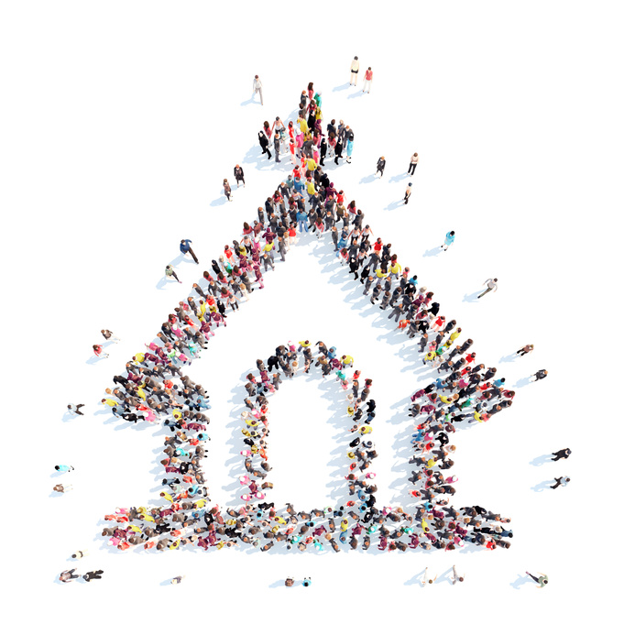
A HEALTHY CHURCH
IN PRAYER ALL THE TIME!
Health Ministries
Inter-American Division

Slide 2
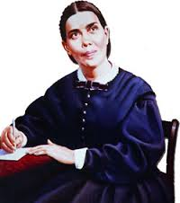
PRAYER: what does it mean?
“Prayer is the opening of the heart to God as to a friend. Not that it is necessary in order to make known to God what we are, but in order to enable us to receive Him. Prayer does not bring God down to us, but brings us up to Him.”
Steps to Christ, 93

Slide 3
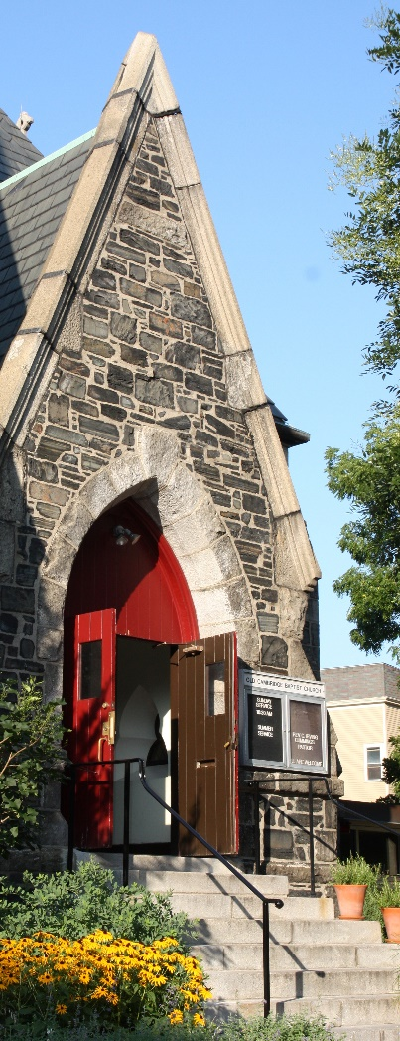
When GOD‘s church is in prayer, there is
Power
Health
Love
Mercy
Fellowship
Enlightenment
Faith
and having all of these, there is
JESUS

Slide 4
POWER
When we as a church, learn to pray effectively, the power of GOD will be reflected in our lives and we’ll see great miracles in our own petitions and in other people’s prayers.
“The prayer of a righteous person is powerful and effective.”
James 5:16, NIV
Notes:
Cuando el rey sajón de Northumberland, Ethelred, invadió Gales y estaba a punto de presentar batalla a los britanos, observo que cerca del enemigo había un grupo de hombres desarmados. Pregunto quienes eran y que hacían. le respondieron que eran monjes de Bangor, orando por el éxito de sus compatriotas. Entones, dijo el príncipe pagano, “ya han comenzado la lucha contra nosotros; ataquémoslos en el acto”
La oración es un arma poderosa. Empléala

Slide 5
“Prayer is the breath of the soul. It is the secret of spiritual power. No other means of grace can be substituted, and the health of the soul be preserved. Prayer brings the heart into immediate contact with the Well-spring of life, and strengthens the sinew and muscle of the religious experience. Neglect the exercise of prayer, or engage in prayer spasmodically, now and then, as seems convenient, and you lose your hold on God.”
In Heavenly Places, 83
There’s power in prayer!

Slide 6
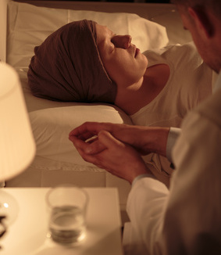
HEALTH
Is anyone among you sick? Let them call the elders of the church to pray over them and anoint them with oil in the name of the Lord. ¹⁵ And the prayer offered in faith will make the sick person well; the Lord will raise them up. If they have sinned, they will be forgiven.
James 5:14, 15

Slide 7
Pray for the sick
The custom of praying for the sick is losing ground. Many times there is a brief announcement that we should pray for “ sister Mary or brother John”… Rather, we should say: “We are going to pray for … and we will visit the home or the hospital where there will be a session of intercessory prayer on behalf of the sick.
We need to practice earnestly and consistently intercessory and thanksgiving prayers.

Slide 8
Matthew 18:20
For where two or three gather in my name, there am I with them. (NIV)

Slide 9
A loving church has to demonstrate love
It is the little things that make the great beauty and success of life. Little deeds of charity, little words of kindness, little acts of self-denial, a wise improvement of little opportunities, a diligent cultivation of little talents, make great men in God's sight.
Sons and Daughters of God, 253

Slide 10
A healthy Church implements “Christ’s Method”
Christ's method alone will give true success in reaching the people.
The Savior mingled with men
He showed His sympathy for them
Then He bade them, "Follow Me.“
Ministry of Healing, 102

Slide 11
A healthy Church is friendly and makes friends as well
A friend loves at all times, and a brother is born for a time of adversity.
Proverbs 17:17

Slide 12
Proverbs 18:24
One who has unreliable friends soon comes to ruin, but there is a friend who sticks closer than a brother

Slide 13
A healthy Church shines by its own light
Matthew 5: 14
You are the light of the world. A city high on the hill cannot be hidden
Wherever your light is shining, others will see it far away.

Slide 14
A healthy Church must be like a beam of light
When a light beam hits a plain surface, it is reflected, following the same angle.
When it hits a surface with a different density, the light beam gets refracted.
A light beam is adapted to the surface being hit.

Slide 15
A faithless Church displeases God
And without faith it is impossible to please God, because anyone who comes to him must believe that he exists and that he rewards those who earnestly seek him.
Hebrews 11:6

Slide 16
FAITH overcomes sin
Faith is the certainty that we were created in God’s image; therefore He made us perfect with the correct dimensions to be developed. Sin distorted that perfect creation.

Slide 17
A healthy Church prays and has faith
The darkness of the evil one encloses those who neglect to pray. The whispered temptations of the enemy entice them to sin; and it is all because they do not make use of the privileges that God has given them in the divine appointment of prayer. Why should the sons and daughters of God be reluctant to pray, when prayer is the key in the hand of faith to unlock heaven's storehouse, where are treasured the boundless resources of Omnipotence?

Slide 18
PRAYER & FAITH
Without unceasing prayer and diligent watching we are in danger of growing careless and of deviating from the right path.
Steps to Christ, 95

Slide 19
Conclusion…
Prayer is a key: if properly polished by constant usage, access to heavenly and earthly treasures will be opened.

Slide 20
A healthy church
PRAYS AT ALL TIMES!

Slide 21
A M E N !!!

