Slide 1
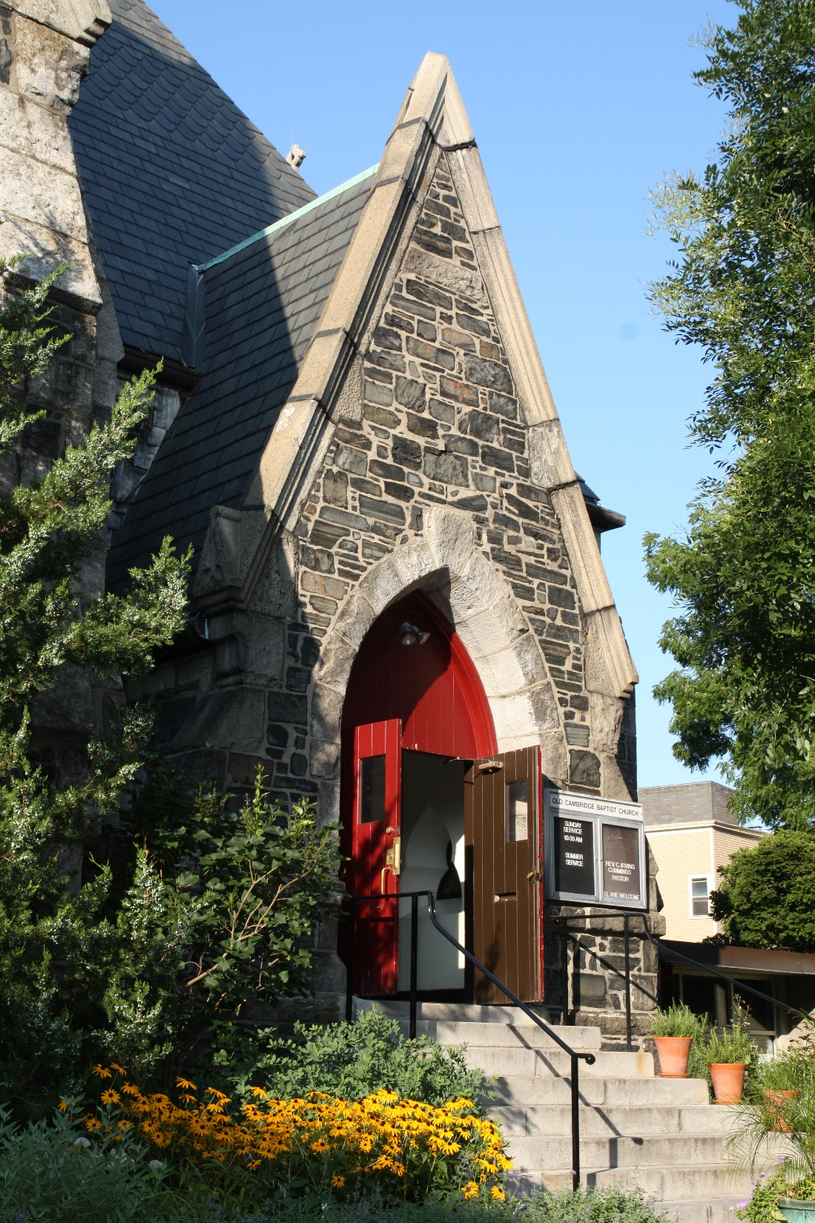
A HEALTHY CHURCH
Practices a Healthy Lifestyle
Health Ministries
Inter-American Division

Slide 2
Mission statement of the Health Ministries
The Inter-American Division Health Ministries Department promotes a healthy lifestyle within the Church and its social environs. We encourage our members wherever they may be to become genuine living testimonies to others, thus awakening in them a spirit of inquiry and opening the door to facilitate the action of the Holy Spirit in their lives.

Slide 3
In current times, when the devil’s deceptions are evident everywhere, the philosophy of the HEALTH MINISTRIES is to encourage Church members, by means of the Divine Grace, to harmonize their lifestyle with GOD’s health laws.

Slide 4
As Seventh-day Adventists, we are to live what we preach.
The healthy lifestyle of the Church is worthless, unless members practice what we promote and preach.

Slide 5
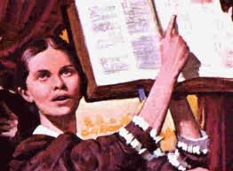
A healthy Church practices healthy habits
There is great need of instruction in regard to dietetic reform. Wrong habits of eating and the use of unhealthful food are in no small degree responsible for the intemperance and crime and wretchedness that curse the world.
Counsels on diet and foods, page 441

Slide 6
A healthy Church practices:
Positive changes in daily living
Habit modification, and substitution of the wrong ones.
Helping the needy -assisting the widows, caring for the orphans, visiting the sick, those in prison...

Slide 7
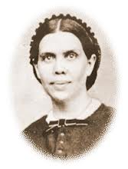
The influence of the Spirit of God is the very best medicine for disease. Heaven is all health; and the more deeply heavenly influences are realized, the more sure will be the recovery of the believing invalid. The true principles of Christianity open before all a source of inestimable happiness. Religion is a continual wellspring, from which the Christian can drink at will and never exhaust the fountain.
Counsels on Health, page 28

Slide 8
Your Church can be a blessing for members and for the community by teaching the activities proposed by a Healthy Church.
Many souls could be carried to the feet of JESUS by practicing healthy habits.

Slide 9
A Healthy Church promotes health by…
Offering courses on Healthy cooking – healthy vegetarian recipes.
Organizing, sponsoring and participating in peaceful public manifestations, against
Tobacco
Alcohol
Drugs
Abuses, misuses…

Slide 10
This opportunity is given to the Church in order to discuss an action plan to implement the practice of a healthy lifestyle.
The “Quiero Vivir Sano” (I want to live healthy) Method may be used to start.

Slide 11
A Healthy Church must pray
For a Holistic Transformation in every Church member’s life.
That we will be able to understand GOD’s will for us ONLY when our lives get transformed by His grace.
Then we will be:
“Transformed by His Grace to Heal & Serve”

Slide 12
Conclusion… As we implement this health message, the Seventh-day Adventist Church will be …
Globally known as a favorite model for a healthy life.
Appreciated as a reliable model, along with other citizens and agencies, to meet the basic needs of humanity today.

Slide 13
AS A CHURCH, we must be publicly respected and admired because of our presence and ministry in every single community where members and/or institutions exist.

Slide 14
JESUS IS COMING AGAIN!

