Slide 1

CHURCH and COMMUNITY
4th Strategic Pillar
PROCLAIM
Health Ministries
Inter-American Division

Slide 2
4th Strategic Pillar
Proclaim
Should members of the Church get together in order to carry on a well organized Health Plan, there will be an awakening and genuine interest among the communities around the churches.

Slide 3
RESULTS FORETOLD
Health Message, properly lived and presented in Healthy Churches, will be the most effective way to proclaim the message of salvation.
Healthy Churches will be
lighthouses for those in darkness.

Slide 4
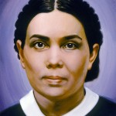
The members of the church are in need of an awakening, that they may realize their responsibility to impart these truths. Those who have been enlightened by the truth are to be light bearers to the world. To hide our light at this time is to make a terrible mistake.
Testimony Treasures, volume 3, 102

Slide 5
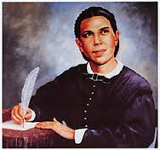
CHRIST’s Church is organized for service. Its watchword is ministry. Its members are soldiers, to be trained for conflict under the Captain of their salvation.
Counsels on Health, 148

Slide 6
Our responsibility
To everyone work has been allotted, and no one can be a substitute for another. Each one has a mission of wonderful importance, which he cannot neglect or ignore, as the fulfilment of it involves the weal of some soul, and the neglect of it, the woe of one for whom Christ died.
Christian Service, 15

Slide 7
1. Church Getting Ready
Before we reach the community with health programs, Church members have to be motivated to see the blessings received, by following a healthy lifestyle.
Every program to be presented for the community, must be well known and practiced by the Church.

Slide 8
Acts 2: 46, 47
Every day they continued to meet together in the temple courts. They broke bread in their homes and ate together with glad and sincere hearts, praising God and enjoying the favor of all the people. And the Lord added to their number daily those who were being saved.
New International Version (NIV)

Slide 9
2. Getting to know our Community
Every Church or Congregation has a different community
Church members are to get acquainted with communities and their major needs
We cannot use the same tools for all communities.

Slide 10
3. Knowing my Church
Which are our human resources?
  Health Professionals
  Pastors / Ministers
  Other professionals
  Committed Church Members
  Other ministries

Slide 11
When Church members are convinced that health habits strengthen the immune system, they will be ready to change their personal lifestyle.
Only when “their deeds speak out” others will be reached with the Health Message.

Slide 12
SUGGESTED PROGRAMS FOR COMMUNITY
  1. Health Fair/Expo
  2. “I want to live healthy”
  3. I want to grow healthy
  4. Breath freely (5-day Plan to Stop Smoking)
  5. Others…

Slide 13
SUGGESTED PROGRAMS FOR COMMUNITY
Discover your numbers
Promote a free assessment on “Get to know your numbers”
  Know your Blood Pressure
  Know your Cholesterol Level
  Know your Blood Sugar Level
  Know your Body Weight / B M Index

Slide 14
Know Your Normal numbers
This activity may last several weeks
Lectures / Speeches on:
Meaning of Blood Pressure
Cholesterol, Triglycerides; how to manage
Blood sugar; explain the risks of Type 2 Diabetes
Overweight; dangers & risks

Slide 15
Suggested Activities
Vegetarian Cooking Club:
  Learn to eat the healthy & delicious way
  A weekly meeting can be enough
Prepare 2 selected recipes – get Nutritionist or Dietitians to prepare them.
Have the dishes partially prepared, so that attendants will be able to taste them before leaving your venue.
Adapt it to your community

Slide 16
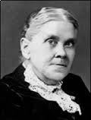
Culinary Science is not a worthless discipline, but one of the most important ones in practical life.
The Lord will give His people wisdom to prepare … Simple combinations of nuts and grains and fruits, manufactured with taste and skill, will commend themselves to unbelievers.
Counsels on Diet and Food, 400

Slide 17
“LET’S MOVE TO LIVE” CLUB
Form an EXERCISE CLUB and program
  Outdoor walks
  Sports, football, baseball, basketball
  Visit the Zoo or any other park
  Family Bicycle Rides
  REASONS MUST BE GIVEN WHY EXERCISE IS IMPORTANT

Slide 18
Emotional & MENTAL Health
Explain emotions and how to control them
Depression and how to get rid of it
Enjoy life: Christian Positive Psychology
Stress: management and control (One- Day without Stress)

Slide 19
OTHER ACTIVITIES
1. Visit the sick
2. Get information about widows within the nearby community
3. Minister to the Orphans
4. Help the homeless and abandoned
    Prepare bags with essential articles
    Prepare food bags, water…
    Give them Christian literature
    Share JESUS with them

Slide 20
The Saviour's commission to the disciples included all the believers… It is a fatal mistake to suppose that the work of saving souls depends alone on the ordained minister. All to whom the heavenly inspiration has come are put in trust with the gospel. All who receive the life of Christ are ordained to work for the salvation of their fellow men. For this work the church was established, and all who take upon themselves its sacred vows are thereby pledged to be co-workers with Christ.
Desire of Ages, 822

Slide 21
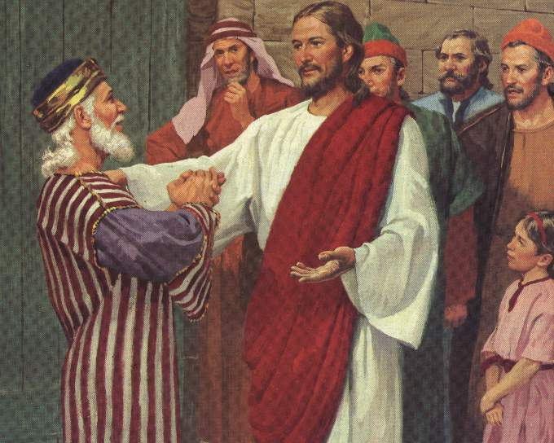
Christ's method alone will give true success in reaching the people. The Saviour mingled with men as one who desired their good. He showed His sympathy for them, ministered to their needs, and won their confidence. Then He bade them, “Follow Me.”
Ministry of Healing, 143

Slide 22
CHRIST’s Method
Jesus –the Master Teacher…
Mingled with men as one who desired their good
Showed His sympathy for them
Ministered to their needs
Won their confidence
He bade them, “Follow Me”.

Slide 23
Conclusion…
In sympathy and compassion we are to minister to those in need of help, seeking with unselfish earnestness to lighten the woe of suffering humanity. As we engage in this work we shall be greatly blessed. Its influence is irresistible. By it souls are won to the Redeemer.
Welfare Ministry, page 121

Slide 24
AMEN!

