Slide 1
PART 1

Slide 2
Lord Transform Me
Is an intentional effort of all SDA Church employees and laity in Inter-American Division to live Christ-like lives, through the empowerment of the Holy Spirit.
Romans 12:2
Notes:
Romans 12:2:
“Be not conformed to this world; but be ye transformed by the renewing of your mind, that ye may prove what is that good, and acceptable, and perfect will of God”.

Slide 3
Desired Outcomes of LTM
Renewal of the mind:
Members are transformed in the
way they live, interact and serve.
Results:
Influence others to accept Jesus Christ as Savior and become His disciples.

Slide 4
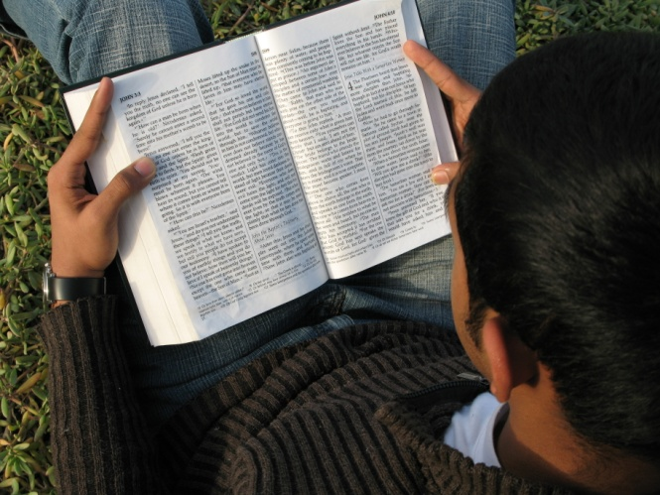
Desired Outcomes of LTM
“Be transformed” - Christians are called upon to dedicate their whole life to God on the basis of His mercy.
Notes:
Romans 12:1
Romans 12:2:
“Be not conformed to this world; but be ye transformed by the renewing of your mind, that ye may prove what is that good, and acceptable, and perfect will of God”.
“Be not conformed to this world; but be ye transformed by the renewing of your mind, that ye may prove what is that good, and acceptable, and perfect will of God”

Slide 5
Results of Transformation
Christians through the Holy Spirit will:
Develop an abiding relationship with Him -Mark 3:13-15
Discern Christ’s righteousness –Malachi 3:17-18
Participate actively in Christ’s mission -Matthew 28:18-20
Notes:
Titus 3: 4-7

Slide 6
Results Of Transformation
Christians through the Holy Spirit will:
Communicate in wholesome ways within the faith community- Ephesians 4:29
Nurture others in the faith -John 15:16.
Do God’s will-
1 Thessalonians 5:16-18.
Notes:
Titus 3: 4-7

Slide 7
FIVE PRINCIPAL COMPONENTS
EXPLORE AND LEARN
CONNECT AND SHARE
PROCLAIM AND REAP
TRANSFORM AND LIVE
CONSERVE AND DISCIPLE
TRANSFORMATION

Slide 8
Transform and Live
This involves all spiritual initiatives to aid each member to become transformed by the Spirit of the Lord to live Christ-like lives, shadowing the righteousness of Christ, exemplifying faithfulness to the Lord and His cause and participating faithfully in the Mission of Christ.

Slide 9
Objectives of Transform and Live
1 | To provide bible-reading initiatives that will inspire and motivate every member of the Church to develop a personal bible reading routine that will help them to increase their bible knowledge and apply the word of God to their personal life.
2 | To engage the members in a special study of the Righteousness of Christ and encourage them to shadow the lifestyle of Christ each day.
3 | To encourage the members to enhance their knowledge of the ministry and counsels of Ellen White and to make personal applications to their lives and ministry.

Slide 10
Objectives of Transform and Live
4 | To engage the members in a renewed study of the 28 fundamental beliefs of the Church
5 | To encourage the members to enhance their personal prayer life through ongoing prayer initiatives.
6 | To encourage every member of the Church to live a life of faithfulness to the Lord in the way they manage their talents, time, resources and body temple and serve the church and others.
7 | To encourage worship leaders in all churches to enhance the worship services through enhancing the elements of each worship service so as to create a transcendental experience for worshipper.

Slide 11
Some Actions to Achieve T&L
A special study of:
Christ’s Righteousness
Revived by the Word Reading plan
Fundamental beliefs
Ongoing prayer initiatives
Emphasis on faithfulness to the Lord and His Mission.

Slide 12
Some Actions to Achieve T&L
Between June 1, 2016 to December 31, 2016:
Conduct study of the Righteousness of Christ in each local church and the institutions.
Each local church shall encourage every member to acquire the “Believe His Prophets” initiative of the church and follow the daily reading guide.

Slide 13
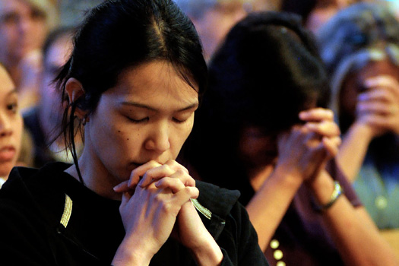
Some Actions to Achieve T&L
“Lord Transform Me” Special prayer initiative shall be organized in each local church, institution and organization of the Division.
Shall be major prayer theme in all the Churches throughout the quinquennium.

Slide 14
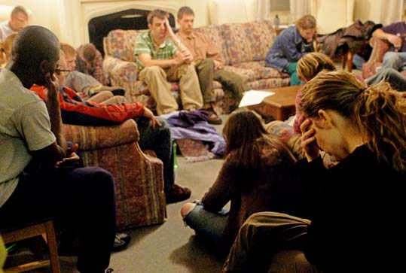
Some Actions to Achieve T&L
“Lord Transform Me” prayer sessions shall be held every Friday night in each home, neighborhood and relevant locations.

Slide 15
Some Actions to Achieve T&L
Personal, congregational and small group, spiritual encounters.
Participants shall focus on:
Their personal need for spiritual transformation
Faithfulness
Participation in Christ’s Mission.

Slide 16
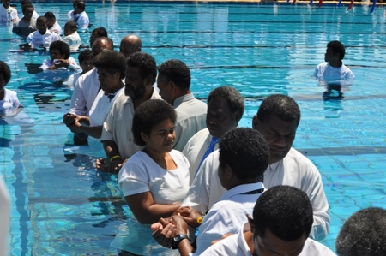
Some Actions to Achieve T&L
Between January 2017 to April 2019:
Study one fundamental doctrine every month in each church and institution in the Division.

Slide 17
Some Actions to Achieve T&L
Between May 2019 and December 2019:
Special study of LTM theme in all churches and institutions.
Division shall make available materials covering each members’ principal areas of life and their management of all the Lord’s given resources.

Slide 18
Explore And Learn
All the didactic approaches for building relational skills and to address specific opportunities for effective Connecting, reaping and consolidation of members.

Slide 19
Objectives of Explore and Learn
1 | To assist every member of the Church to identify his or her talents, passion, interests and spiritual gifts.
2 | To train them to utilize their talents, gifts and skills in fulfilling their role in the execution of the mission of the Church.
3 | To conduct relevant surveys within the church and the wider community to determine social and other needs as available resources in order to address deficiencies and affirm strengths.

Slide 20
Objectives of Explore and Learn
4 | Develop curriculum and structure training modules based on perceived needs, to equip members with requisite skills and competencies to make meaningful impact in fulfilling the mission.
5 | Train members how to attract the interest and attention of non-Adventists and conduct bible studies with them.
6 | To develop appropriate materials and resources and mentoring and coaching opportunities to ensure success in the connect and share, proclaim and reap and conserve and disciple initiatives.

Slide 21
Objectives of Explore and Learn
7 | To assist Pastors in contextualizing the Lord Transform Me initiative and develop their own implementation strategic plan.
8 | To train Unions and local fields Evangelism Training and Development directors, pastors and local church LTM team members to effectively execute their duties.

Slide 22
Objectives of Explore and Learn
9 | To encourage the members to enhance their personal spiritual lives by taking adequate time each day for pause, reflection and meditation.
10 | To train individuals within the organization to hone their leadership skills, innovate, lead groups and ministries and effectively manage in times of change to realize desired outcomes.

Slide 23
Some Actions to Achieve E&L
Every member be invited to explore their strengths and growth areas in order to utilize them in increasing their faithfulness to the Lord, and participating in His cause.

Slide 24
Some Actions to Achieve E&L
For effective mission participation, members should seek training to develop:
Competencies,
Skills
Concepts
Principles

Slide 25
Some Actions to Achieve E&L
Survey of the local congregation and any community to be evangelized by the congregation be done to determine:
Needs of the congregation,
What members can execute
What deficiencies to be addressed

Slide 26
Some Actions to Achieve E&L
Every church department to identify projects to be undertaken in order to fulfill the mission within and outside local congregation.
Solicit participation of members in projects and train them to fulfill specific roles.

Slide 27
Some Actions to Achieve E&L
Pastors and directors of ministries to create training modules adopted to specific projects.
Availability of qualified trainers to impart knowledge, skills and values to members, for effective participation in the mission.

Slide 28
Some Actions to Achieve E&L
Directors at the Division, Union and local field levels be involved in identifying mission projects and preparing training materials.
Their availability in assisting pastors and other identified trainers in equipping members for service.

Slide 29
Some Actions to Achieve E&L
Union, local field and local congregation should set dates each year for the training of pastors, other employees and members to execute the established mission projects.

Slide 30
Connect and Share
The deliberate, contextualized initiatives undertaken to initiate contact with others on a social level leading to friendly relations, study God’s word, and interest in the Seventh-day Adventist message.

Slide 31
Objectives of Connect and Share
1 | To help both members and non-members to deal with their social, physical and emotional issues.
2 | To encourage Non-Adventists to develop interest in spiritual matters and assume intimate relationship with the Lord.
3 | To help every congregation to determine the best possible method to attract the attention of individuals and organizations outside the Adventist faith and build friendly relationships with them.

Slide 32
Objectives of Connect and Share
4 | To help every member to determine the best possible method to attract the attention of other members of the Church and develop friendly relations with them.
5 | To help every member to determine the best possible method to attract the attention of persons outside the Church and develop friendly relations with them.
6 | To encourage every member of the church to have at least two Contact and Share Associates at all time. One should be a member of the Church; the other should be a non-member who is a prospect for church membership.

Slide 33
Some Actions to Achieve C&S
Aim:
Preparing individuals to accept Christ as their Savior and become members of the Seventh-day Adventist Church.

Slide 34
Some Actions to Achieve C&S
Connect and share approach is about:
Helping others deal with their social, physical and emotional issues.
Encouraging others to take interest in spiritual matters.
Assuming intimate relationship with the Lord.

Slide 35
Some Actions to Achieve C&S
Union, local field and local
congregation should determine:
The best possible method to attract the attention of individuals outside the faith.
How to build friendly relationships.
Deploy the members to undertake such endeavor.

Slide 36
Some Actions to Achieve C&S
Every church member should have at least two Contact and Share Associates.
I. A member of the Church, and a non-member.
The Adventist shall be the “Lord Transform Me” Initiative Associate.

Slide 37
Some Actions to Achieve C&S
II. The non-member shall be the soul winning mission contact.
Every effort should be made under the direction of the Holy Spirit to reap the non-Adventist into the body of Christ and membership in the SDA Church.

Slide 38
Some Actions to Achieve C&S
After baptism of the Non-Adventist Contact and Share Associate into the church, the member should add another, while keeping the relationship with the new member in order to assist in conserving and discipling the individual.
Every Church member should always have at least one Contact and Share Associate.

Slide 39
Some Actions to Achieve C&S
Importance of organization:
Provision of appropriate and sufficient materials and resources.
Mentoring and coaching for successful connect and share.

Slide 40
Some Actions to Achieve C&S
Before every evangelistic proclaim and reap program is held, proper, well prepared ,executed connect and share programs should be done.
Every church member should be invited and trained to participate in Connect and Share initiatives on an annual basis.

Slide 41
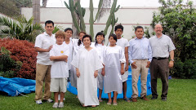
Proclaim and Reap
All personal and public evangelistic activities that motivate individuals to:
Find security in Christ
Make decisions to accept Him as their Savior
Become members of the Seventh-day Adventist Church.

Slide 42
Objectives of Proclaim and Reap
1 | To train and equip pastors to proclaim the gospel of Christ and reap souls for His kingdom.
2 | To train and equip pastors to train and equip their members to proclaim the gospel of Christ and reap souls for His kingdom.
3 | To train Pastors to conduct regional proclaim and reap campaigns in their pastoral districts.
4 | To determine the most appropriate time each year to conduct proclaim and reap campaigns.

Slide 43
Objectives of Proclaim and Reap
5 | To conduct annual Proclaim and Reap campaigns at the local Church/Pastoral district, local field, Union and Division levels each year.
6 | To train a cadre of members to serve in various categories is an evangelistic proclaim and reap campaign.
7 | To determine a special financial plan for each Special Proclaim and Reap Campaigns
8 | To encourage each Union to strategize in order to realize an annual 8% increment in baptisms.

Slide 44
Some Actions to Achieve P&R
Pastors and church members organize themselves for effective personal and public evangelism to reap souls for the kingdom.
Public evangelism- most effective method of speaking to and persuading both small and large groups of individuals to Christ in a single experience.

Slide 45
Some Actions to Achieve P&R
Each Union, local field and congregation should determine a time one year in advance to conduct intensive Proclaim and Reap impacts.
Intensive Contact and Share initiatives be conducted by members to adequately prepare people for decision making during the proclaim and reap.

Slide 46
Some Actions to Achieve P&R
Annual Proclaim and Reap campaign meetings:
Union and Division
Local Field
Local Church/Pastoral District

Slide 47
Some Actions to Achieve P&R
P&R apprenticeship training initiative- be conducted to achieve greater effectiveness in soul winning.
Proclaim and reap campaigns:
Duration: Not less than two weeks.
specialists in selected areas train participants according to their interest and passion areas.

Slide 48
Some Actions to Achieve P&R
Annual Proclaim and Reap Campaigns:
Local
Union/
Division
Regional

Slide 49
Some Actions to Achieve P&R
The Annual Regional Local Field Proclaim and Reap Campaign:
Initiative of each local field.
Campaign Attendees :
Church Members and non-Members

Slide 50
Some Actions to Achieve P&R
Intent: Baptize a significant number of persons and train:
District/ Church Pastors
Ministerial students in training
Prayer Coordinators
Lay Evangelists
Lay Bible workers
Conference employed bible workers
Lay witnesses
Technology in Evangelism Providers

Slide 51
Some Actions to Achieve P&R
The Annual Church/District Proclaim and Reap Campaign:
Attendees: Members and non-members.
Lay Bible Workers
Lay Witnesses
Prayer Coordinators
Technology in Evangelism Providers
Lay Evangelists
Intent: Baptize a significant number of persons and train:

Slide 52
Some Actions to Achieve P&R
The Church or district Pastor shall mirror training conducted at the regional level proclaim and reap campaign and improve the model.

Slide 53
Some Actions to Achieve P&R
The Annual Union/Division Proclaim and Reap Campaign.
Yearly invitation of all unions to participate in the Proclaim and Reap Initiative at the principal site selected by the Division.

Slide 54
Some Actions to Achieve P&R
Union Assistant to the President for Evangelism
Chosen Local Field Evangelism Directors
District /Church Pastors of the Union
Ministerial Students on Training
Prayer Coordinators
Lay Evangelists
Lay Bible Workers
Conference Employed Bible Workers
Lay Witnesses
Technology in Evangelism Providers
Attendees for training at the Union/Division P&R Campaigns:

Slide 55
Some Actions to Achieve P&R
Principal site for the Union/Division Proclaim and Reap and LTM Convention annual program:
2016
East Venezuela
Union
2017
Inter-Oceanic Mexican union
2018 Haitian Union
2019 Atlantic Caribbean union
2020
South central American union

Slide 56
Some Actions to Achieve P&R
The Regional campaigns shall be financed by:
Financing the Special P&R Campaigns:
Union contribution
other
Funding from local fields
Contribution from participating churches
Members evangelism contribution
Special Evangelism

Slide 57
Some Actions to Achieve P&R
Financing the Special P&R Campaigns:
Annual church/ District P&R campaigns:
Members Contribution
Participating Churches contribution
Special Evangelism fundraising projects
Local field funding
Other

Slide 58
Some Actions to Achieve P&R
Presenters at the P&R Campaigns:
Evangelism Trainers
Union
Local Field
Local Church Pastors
Division
Qualified/
Experienced Trainers
Guest Evangelists

