Slide 1
Retirement Planning Seminar
Dr Carson L. Greene

Slide 2
This seminar is designed to assist workers with their preparation for retirement. All workers will benefit from the seminar but those above fifty should give special attention to the issues raised here.

Slide 3
Theological Foundations
1 Tim 5:8
But if any provide not for his own, and specially for those of his own house, he hath denied the faith, and is worse than an infidel.
Notes:
Providing a theological foundation for retirement will help the worker to see that God has outlined principles in his word that are designed to demonstrate that it is a wise practice to plan for retirement.
The intent in using this text is to show that the matter of providing for one’s needs is a divine mandate. 1 Tim 5:8 is relevant not just to one’s working life but to one’s entire scope of existence.

Slide 4
Luke 14:28-30
28 For which of you, intending to build a tower, sitteth not down first, and counteth the cost, whether he have sufficient to finish it? 29 Lest haply, after he hath laid the foundation, and is not able to finish it, all that behold it begin to mock him, 30 Saying, This man began to build, and was not able to finish.
Notes:
Discuss the retirement principles in this text.

Slide 5
Pharaoh’s Dream –Gen 41:17 – 36
Note Joseph’s counsel –verses 34 – 36:
34 Let Pharaoh do this, and let him appoint officers over the land, and take up the fifth part of the land of Egypt in the seven plenteous years.
Notes:
Joseph’s instructions to Pharaoh was that wisdom dictates that one should use the years of plenty to prepare for the years of little. One’s work life may be considered the years of plenty in this context.

Slide 6
35 And let them gather all the food of those good years that come, and lay up corn under the hand of Pharaoh, and let them keep food in the cities. 36 And that food shall be for store to the land against the seven years of famine, which shall be in the land of Egypt; that the land perish not through the famine.

Slide 7
Before sin, God ordained work. Adam was placed in the Garden of Eden with the responsibility of “keeping” it. Gen 2:15
As Seventh-day Adventist, we understand the obligation of work as part of the fourth commandment. “Six day shalt thou labour and do all they work..” Ex 20:9
Notes:
This seminar is designed primarily for workers but may also be used for church members. If the seminar is done on a Sabbath afternoon as a stewardship seminar, it is a good idea to show the relationship between Sabbath and work and hence retirement.

Slide 8
Why Focus on Retirement
Work
Retirement
Preparation for work
Notes:
This diagram outlines one’s lifespan. The intent here is to illustrate that one section should prepare for the other.

Slide 9
Life Expectancy in Montserrat
Male: 75.31
Female: 71.91
Overall: 73.65

Slide 10
Life Expectancy in Antigua (index mundi 2012 estimates)
Male 73.66
Female 77.83
Overall: 75.69

Slide 11
Life Expectancy in St Kitts (WHO 2011 DATA)
Male 70.8
Female 77.4
Overall: 74

Slide 12
Retirement is generally viewed as a time when a worker lays off the frustration of daily work and enjoys a life of ease. In reality though, it can pose a number of serious challenges.
Inadequate finance
Sickness and Increasing heath care cost
loss of heath insurance
Death of spouse
Social challenges
What to do with one’s time

Slide 13
Important Considerations:
Ensure you have adequate housing
It is important to have your own house
It is important to complete your mortgage payments
Know what your income will be and prepare for the consequences
Have a plan for your time—a good hubby will be helpful
Have a good healthcare option

Slide 14
Important Considerations
LIVE

Slide 15
L | I | V | E
Longevity You or your spouse may live to be 90 or 95 years old. Do you have enough money to live more than 25 years in retirement? | Inflation The goods and services you buy today may cost more tomorrow. Are you prepared for a drop in your purchasing power? | Volatility A volatile financial market can wipe out your retirement investments. Do you have the proper protection to weather a bad storm? | Expectations If you want the same lifestyle in retirement you probably need to save more today. Are your expectations out of line with your bottom line?
Taken from Jackson.com retirement planning

Slide 16
The Longevity Challenge
Ensure that your savings will last 20 years or more. Wherever you are on the path to retirement, it´s important to start saving early for more retirement choices later. A little saved over a long period of time can really add up.
Develop a long-term retirement plan. Work with a representative to tailor a financial plan that works for you. Then stick to that plan. Consider investing in products that guarantee income for life.

Slide 17
The Inflation Challenge
Inflation is a rise in the general level of prices of goods and services in an economy over a period of time.

Slide 18
How is Inflation Measured?
The Consumer Price Index (CPI) measures inflation. It is calculated by taking a basket of goods and comparing its average price at two intervals in time, while adjusting for changes made to those goods.
The CPI is the most commonly reported inflation data in the United States. Historically, the inflation rate has averaged 3.3%.¹
1 U.S. Inflation Calculator, Historical Inflation Rates: 1914 - 2010, Annual and Monthly Table, as of May 2010.

Slide 19
So How Worried Should You Be?
Consider that you have $10,000 in the bank. At just a 3% inflation rate, the spending power of your $10,000 is reduced by 25% after 10 years and cut almost in half after 20 years! Put another way, if you need $65,000 a year to live on today, assuming a 3% annual inflation rate, you´ll need nearly double that amount in 25 years, just to maintain your current lifestyle.²
2 Farrell, Charlie, MoneyWatch, "Quickly Estimate How Much You'll Need for Retirement," May 1, 2009.

Slide 21
The Inflation; consumer prices (annual %) in St Kitts and Nevis was last reported at 5.93 in 2011, according to a World Bank report published in 2012. Inflation as measured by the consumer price index reflects the annual percentage change in the cost to the average consumer of acquiring a basket of goods and services that may be fixed or changed at specified intervals, such as yearly.

Slide 22
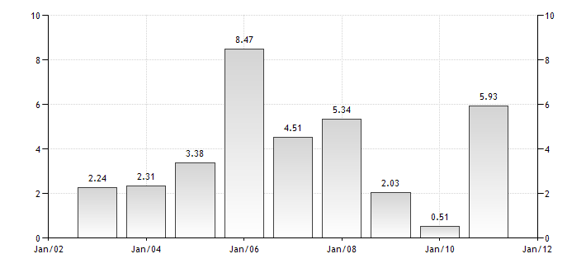
Inflation in St Kitts and Nevis (World Bank 2012 report)

Slide 23
Inflation in Antigua and Barbuda

Slide 24
The Volatility Challenge
Manage your investment mix as you age. As you get older, you may want to adjust your investments based on your risk tolerance.
Stay focused on the long term.

Slide 25
The Expectation Challenge
It´s time to get real about your retirement.
Re-evaluate your retirement plan. It´s possible that the amount you are currently saving isn´t going to provide you with the retirement lifestyle you´ve envisioned.

Slide 26
Understanding Social Security
In this section, officials from Social Security will be on hand to explain how the system works and to answer questions.
Notes:
Some countries may not have Social Security or may have a similar system such as National Insurance. The point here is that persons need to be able to understand how the system works. I suggest that arrangements be made with officials from the particular department of organization to explain the system so that the worker is fully aware of what to expect at retirement.

Slide 27
Understanding the denominational retirement plan
For this section, the Treasury and Secretarial personnel will provide an overview of the denominational retirement system and answer questions.

