Slide 1
Spiritual Gifts and The Church Election Process

Slide 2
Introduction:
In most congregations across the Mission, officers are selected without any real assessment of the individual’s spiritual giftedness.

Slide 3
For example, when selecting elders, the chairman of the committee may typically ask, How many Elders do we need? If, let’s say, seven is decided on, the floor is then opened up of nominations.

Slide 4
Those nominations are made, most times, based on the committee members perception of the person or based on the fact that the individual has served in the office before. But since it is the Holy Spirit that determines a persons giftedness, how do we know that the person we are nominating for the particular position has the necessary gifts to effectively carry out that ministry?

Slide 5
This seminar is designed to help the Pastor/Nominating Committee Chair to effectively make assignments based on spiritual gifts and not simply on the basis of a nomination or a person’s preference.

Slide 6
The Purpose of Spiritual Gifts
A spiritual gift is a special ability given to a member of the body by the Holy Spirit that enables him to work effectively and with joy in helping the Church to carry out its mission in the world.

Slide 7
In its widest, deepest sense it is the call of God coming to an individual in the body singling him/her out for a particular ministry and carry with it the ability to perform that ministry.

Slide 8
A spiritual gift is a believer’s spiritual job description

Slide 9
Who Gives The Gifts?
1 Cor 12:7-11 (The Holy Spirit)
Purpose
Rom 12:4-8; 1 Cor 12 and Eph 4:4-13 all tell us that the gifts are given for the effective working of the body—the Church of Jesus.

Slide 10
Implications:
Members therefore need to know and understand their gifts

Slide 11
Conducting a Spiritual Gifts Seminar
Prepare your Church
Plan—select a good time. The seminar is best done over a period of time rather then in one day or even one weekend.
  It can be a one week—Sunday, Wednesday, Friday and Sabbath
  It can be a week end: Friday, Sabbath morning and Sabbath afternoon.
  It can be every Sabbath in a Month.

Slide 12
Promote
  A seminar is only effective if persons attend it. Everything must be done to motivate members
  Since this is a pastor led church, the pastor must take the lead in promoting this initiative. Make it exciting!

Slide 13
The Seminar
  Explain the various aspects of the seminar
  Demonstrate scoring the seminar
  Highlight the need for confirmation from members
  Emphasize the importance of obtaining the information for your records.

Slide 14
The Election Process
Church officers are chosen every one or two years. The church manual provides instruction regarding the church election process and specifically states the task of the nominating committee as that of preparing a list of nominees for all offices of the church with the exception of Sabbath School teachers. What it does not state is the basis on which nominations are to be made.

Slide 15
Since spiritual gifts are given to members for the purpose of serving, it follows that members are to be assigned responsibilities based on their gifts. After all, a spiritual gift is the believer’s spiritual job description.

Slide 16
The church manual provides a sample list of possible officers that may be elected to serve in the church. This can be found under the notes section as chapter nine notes. It is important to note that this is a guide. Each congregation will need to make selections based on its particular needs.

Slide 17
The traditional approach to filling the list of officers is for committee members to determine the number of officers needed for a particular department and then to make nominations as per committee members’ thoughts.

Slide 18
What is being proposed here is a structured system of making assignments based on the spiritual giftedness of members.

Slide 19
Step One.
The congregation will need to provide instruction to members in the area of spiritual gifts and ascertain the spiritual gifts profile of each member. This needs to be done before the election process.

Slide 20
The church clerk should keep this information in the membership database along with other relevant information such as talents and skills of the members.

Slide 21
The church clerk should provide the committee chair with a membership profile highlighting the members names, status, spiritual gifts, talent/skills and an area for possible areas of service.

Slide 22
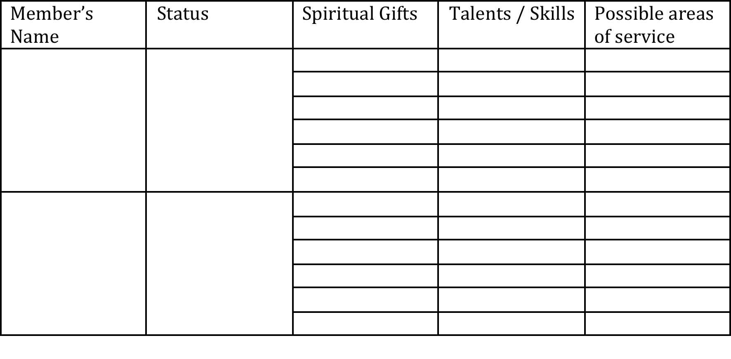
Sample membership profile:

Slide 23
Step Two:
At the first meeting of the nominating committee, earnest intersession needs to be made for the Holy Spirit’s guidance in the election process. The chairperson of the committee (the Pastor in most cases) should then provide general instruction such as the need to be confidential and the importance of the exercise that is being undertaken.

Slide 24
The needs of the church should be shared and a determination made with respect to the list of officers to be selected.

Slide 25
Step Three:
The committee should complete final section of the members profile if it is not yet complete. The following guide should be used in this process. This is a listing of the spiritual gifts needed to effectively serve in the respective offices.

Slide 26
It is important to note that some offices will require a particular skill set. An example is the organist. It is important to note in these cases, the individual will best serve if he or she has the relevant spiritual gift to allow them to use their skill in ministry.

Slide 27
Elders:
  Administration, Leadership, Exhortation, Shepherding, Hospitality

Slide 28
Deaconry
  Helps, service, hospitality, mercy, administration (head)
Clerk
  Organization, Helps, Service

Slide 29
Treasurer
  Organization, Administration, Encouragement, Faith, Giving, Wisdom
Children’s Ministry
  Administration, Leadership, Faith, Shepherding, Encouragement

Slide 30
Church Chorister:
  Service
Church Organist:
  Service
Education Secretary:
  Encouragement, Faith, Organization

Slide 31
Family Life:
  Teaching, Encouragement
Personal Ministries
  Evangelism, Leadership, Knowledge, Wisdom, Teaching
PM Sec
  Evangelism, Organization

Slide 32
Interest Coordinator
  Evangelism, Encouragement, Hospitality
Community Services
  Helps, Mercy, Faith, Leadership (Head)

Slide 33
Sabbath School Superintendent
  Administration, Leadership, Evangelism, Encouragement,
Ass Superintendent
  Teaching, Hospitality, Leadership, Shepherding, Faith
SS Sec
  Organization, Service

Slide 34
Investment Secretary
  Faith, Encouragement, Wisdom, Leadership
A Y Leader
  Leadership, Shepherding, Encouragement, Discernment, Faith
Pathfinder
  Shepherding, Leadership, Administration, Encouragement

Slide 35
Step Four:
Once the members’ profile is complete, the committee should then consider the various offices and write down the possible candidates for that office based on the members profile. It is important to note here that selections are to be made based on the spiritual gifts. This way, each person is considered based on his or her spiritual giftedness.

Slide 36
Once the possible candidates are filled in for a particular office, discussion should then take place relative to the moral fitness, availability, and number of persons required etc. Once the discussion is done, a determination is made. The form below can be used as a guide.

Slide 37
