Slide 1

Will Making for the end of life
Anthony St. E. Hall
Pastor/Attorney-at-law

Slide 2
Planned Giving & Trust Services
One goal is to help members overcome the fear of estate planning.
The prophet Isaiah was sent to King Hezekiah with this counsel, "Put your house in order, because you are going to die" (Isa. 38:1, NIV).

Slide 3
A Foundation for Planned Giving & Trust Services
Based on ordinary Stewardship Principles

Slide 4
A Basis for Planned Giving & Trust Services
The Ownership Principle
a. God is owner of all.
b. We are only managers, trustees, or stewards.
c. God wants us, not just our gifts.
The Debtor Principle
a. Salvation makes us debtors to God.
b. And to those around us.
c. Sacrifice is the Christian lifestyle.

Slide 5
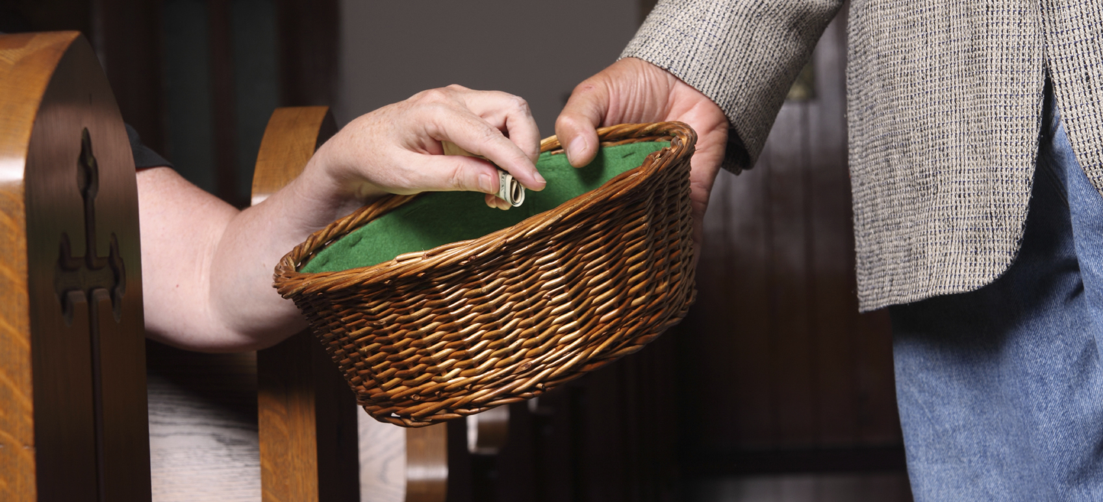
Everything comes from You, and we have given You only what comes from Your hand. 1Chronicles 29:14

Slide 6
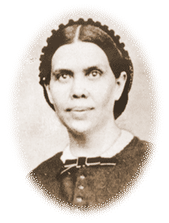
It is utter folly to defer to make a preparation for the future life until nearly the last hour of the present life. It is also a great mistake to defer to answer the claims of God for liberality to His cause until the time comes when you are to shift your stewardship upon others.
Counsels on Stewardship, 325

Slide 7
Those who wait till death before they make a disposition of their property, surrender it to death rather than to God. In so doing, many are acting directly contrary to the plan of God plainly stated in His word. —Counsels on Stewardship, 325

Slide 8
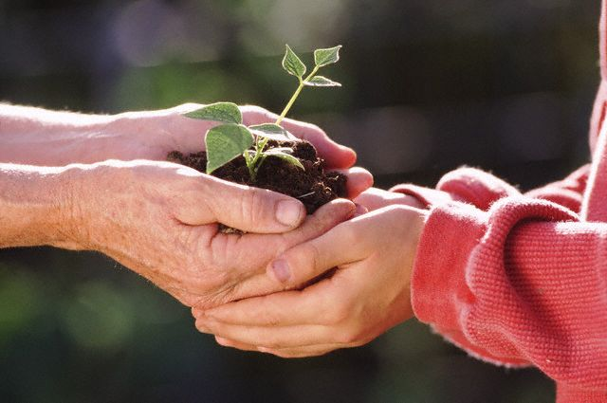
Received & Returned
“Wealth will prove a blessing if we regard it as the Lord's, to be received with thankfulness and with thankfulness returned to the Giver.” 6T 452

Slide 9

WHAT IS “A WILL”
... a document containing your instructions and wishes as to how your property and assets are to be distributed after your death and signed in compliance with the various formalities covered by legislation.”

Slide 10
Myths:
Young and have plenty of time.
If I make a will I will die.

Slide 11
The Adventist Home, page 396,
“Many are not exercised upon the subject of making their wills while they are in apparent health. But this precaution should be taken by our brethren. They should know their financial standing and should not allow their business to become entangled. They should arrange their property in such a manner that they may leave it at any time.”

Slide 12
The Adventist Home, page 397
Wills should be made in a manner to stand the test of law. After they are drawn, they may remain for years and do no harm, if donations continue to be made from time to time as the cause has need. Death will not come one day sooner, brethren, because you have made your will.

Slide 13
The Adventist Home, page 397
“In disposing of your property by will to your relatives, be sure that you do not forget God's cause. You are His agents, holding His property; and His claims should have your first consideration. Your wife and children, of course, should not be left destitute; provision should be made for them if they are needy. But do not, simply because it is customary, bring into your will a long line of relatives who are not needy.”

Slide 14
“If they have children who are afflicted* or are struggling* in poverty,* and who will make a judicious use of means*, they should be considered.

Slide 15
But if they have unbelieving children* who have abundance of this world,* and who are serving the world,* they commit a sin against the Master who has made them His stewards,

Slide 16
… by placing means in their hands merely because they are their children.” C.S. 330

Slide 17
THE CHRISTIAN WILL
PROVIDES:
For Loved Ones
For those less fortunate
For the Lord’s work

Slide 18
WHY MAKE A WILL?
To make gifts to persons / charities of choice - eg. Church, Red Cross
to make special provision for certain dependants - Trust, appoint guardians
to appoint trustworthy person(s) to administer estate
most importantly, ensures you have left a clear statement of your wishes, helping to avoid adding extra stress for your family
to avoid intestacy - i.e. no will made…… Intestate Succession Act will apply

Slide 19
CLASSES OF PERSONS ENTITLED TO INHERIT ON AN INTESTACY
Eastern Caribbean (with the exception of St Vincent & the Grenadines, Grenada and St Lucia)

Slide 20
CLASSES OF PERSONS ENTITLED TO INHERIT ON AN INTESTACY
The Intestate Estates Act Cap 225 (Antigua)
Husband/Wife
The surviving husband/wife takes:-
1) The personal chattels absolutely. Personal chattel includes furniture and effects, articles of the household, motor vehicle, a moveable house, jewellery and other personal effects.

Slide 21
CLASSES OF PERSONS ENTITLED TO INHERIT ON AN INTESTACY
The Intestate Estates Act Cap 225 (Antigua)
Husband/Wife
The surviving husband/wife takes:-
.
2) If there is no issue i.e. children, grand children or next- of- kin, the whole of the residuary estate.

Slide 22
CLASSES OF PERSONS ENTITLED TO INHERIT ON AN INTESTACY
The Intestate Estates Act Cap 225 (Antigua)
3) If there is only one child of the intestate two-thirds (2/3) of the rest of the estate after the personal chattels has been distributed.
4) If there is more than one child of the intestate one-third (1/3) of the rest of the estate after the personal chattels has been distributed. .

Slide 23
CLASSES OF PERSONS ENTITLED TO INHERIT ON AN INTESTACY
The Intestate Estates Act Cap 225 (Antigua)
5) If no child or other issue of the intestate but surviving parent or parents, two thirds (2/3) of the rest of the estate after the personal chattels has been distributed.

Slide 24
CLASSES OF PERSONS ENTITLED TO INHERIT ON AN INTESTACY
The Intestate Estates Act Cap 225 (Antigua)
6) If no issue, but next-of-kin, two-thirds (2/3) of the rest of the estate after personal chattels has been distributed.
7) If any child dies before the deceased leaving a child born at the date of the intestate’s death, the surviving husband/wife takes the same share of the estate as if that child had been living.

Slide 25
CLASSES OF PERSONS ENTITLED TO INHERIT ON AN INTESTACY
The Intestate Estates Act Cap 225 (Antigua)
Issue – includes children, grandchildren and great grandchildren
If the issue is under the age of twenty-one (21) years their portion will be held in trust until they become 21 or marries under that age.

Slide 26
CLASSES OF PERSONS ENTITLED TO INHERIT ON AN INTESTACY
1. If the intestate leaves no husband/wife the estate in equal shares.
2. If husband/wife the remainder of the estate in accordance with 3 and 4 under husband/wife category above.
An adopted child does not fall within this category and they are not entitled to the intestate estate under the Act.

Slide 27
CLASSES OF PERSONS ENTITLED TO INHERIT ON AN INTESTACY
The Intestate Estates Act Cap 225 (Antigua)
Parents
1. If no husband/wife or issue, the parent/parents take estate (if more than one in equal shares)
2. If husband/wife but no issue parent/parents take estate after payment or appropriation of entitlement of husband/wife see number 5 under husband/wife category.

Slide 28
CLASSES OF PERSONS ENTITLED TO INHERIT ON AN INTESTACY
The Intestate Estates Act Cap 225 (Antigua)
Bother/Sister
Brother and sister includes half blood, that is half-brother/sister
1. If no husband/wife or issue or parents brother and sister take estate in equal shares.
2. If a brother and sister do not survive the decease, the children of the brothers and sister take the estate in equal shares.

Slide 29
CLASSES OF PERSONS ENTITLED TO INHERIT ON AN INTESTACY
The Intestate Estates Act Cap 225 (Antigua)
Next-of-kin
Next-of-kin is defined as the person who, at the date of death of the intestate, stands nearest in blood relationship to him.
1. If the deceased dies leaving neither husband/wife nor issue nor parents nor siblings nor children of any deceased sibling, then the estate is taken by the next-of-kin.

Slide 30
CLASSES OF PERSONS ENTITLED TO INHERIT ON AN INTESTACY
The Intestate Estates Act Cap 225 (Antigua)
The crown
In default of any person taking the estate of a deceased his shall vest in the crown. Simply put, the estate will go to the government of Antigua and Barbuda.

Slide 31
Who should make a Will?
You are married and have children
You live with your partner but you are not married
You are a homeowner
You set up your own business or firm
You are getting divorced or separated
You wish to leave some money/assets to your relatives
You wish to leave some money/assets to someone with disabilities.
You want to give some money/assets to a charity or a special cause.

Slide 32
Formal Requirements
For a will to be valid and consequently to be admitted to probate, the following requirements must be met:
(a) It must be made by a person who has attained the age of majority;
(b) It must comply with certain formal requirements laid down by statute.*
(c) The testator or the person making the will must have the testamentary capacity or what is referred to as the animus testandi to make such will.
* Succession Act 1981, Cap 249 (Barbados), s 61(1).
Wills Act Cap 473 Antigua s. 6-9

Slide 33
“No will shall be valid unless:
(a) it shall be in writing
(b) it shall be signed at the foot or end thereof by the testator or by some other person in his presence and by his direction, and

Slide 34
(c) such signature shall be made or acknowledged by the testator in the presence of two or more witnesses present at the same time; and such witnesses shall attest and shall subscribe the will in the presence of the testator...”
Succession Act 1981, Cap 249 (Barbados), s 61(1). Wills Act Cap 473 Antigua s. 7-9

Slide 35
animus testandi
In order to possess the necessary animus testandi to make a will, it must be established:
(a) that the testator had the mental capacity to make the will;
(b) that the testator knew and approved of the contents of his will; and

Slide 36
animus testandi
(c) that the will was that of a free and capable testator, that is, he must have exercised his genuine free choice in the making of his will and more particularly that he did not make it as a result of the undue influence or fraud of another.

Slide 37
Marital rights.
If real property is owned by a person as a joint tenant with another party, such as a spouse, the property automatically passes under the law of survivorship to the surviving party upon death of the testator, unless there was a prior severance of the joint tenancy.

Slide 38
Minors cannot legally hold any Estate
If it is intended to devolve property to minors, then provision should be made in the will for the property to be held in trust for the minors until they reach the age of majority.

Slide 39
WITNESSING A WILL
At least 2 persons required
both must be present at the same time
both must see testator sign will together
both must not be beneficiaries or spouse of beneficiaries

Slide 40

CAN CHANGES BE MADE TO THE WILL ?
Yes - by way of a supplemental will -“codicil”
adding or crossing out words in existing will not valid generally
better to make a fresh will
can make many wills but only the last will is valid

Slide 41
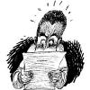
CIRCUMSTANCES REQUIRING CHANGES
Marriage
change of name
executor/beneficiary/witness dies
sale/disposal of assets specified in will
purchase/acquisition of new assets
will needs to be reviewed regularly

Slide 42
WHERE TO KEEP THE WILL?
safe place eg. Safe deposit box
lawyer’s office
Repository of wills at registration department
tell executor/family

Slide 43
COST OF MAKING A WILL?
Ask lawyer for estimate
typically $250 to $350 for a simple will
depends on complexity and time spent making the will
attendance at home or hospital etc to take instructions and to witness will - time cost incurred

Slide 44
EXAMPLE OF A WILL
THIS IS THE LAST WILL AND TESTAMENT of me, DIC TATOR of Lot No. 1 Control Avenue, Know it all Road, in the parish of I Run Things in this island hereby revoking and making void all former Wills and other Testamentary dispositions made by me and declaring this to be my Last Will and Testament.
1. I appoint my wife AGI TATOR to be the sole Executrix and Trustee (herein after referred to as “my Trustee) of this my will.

Slide 45
EXAMPLE OF A WILL
2. I HEREBY GIVE:
(a) $10,000-00 to my sister SPEC TATOR.
(b) my Rolex watch to my brother IMI TATOR.
(c) my 1 Square foot Property at IF YOU MARRY AGAIN I WILL DISINHERIT YOU, to my wife AGI TATOR.
3. I give all my real and personal property situate at WELL HIDDEN FROM MY FAMILY to my TRUSTEE UPON TRUST to sell, call in and convert the same into money with power to postpone the sale, calling in and conversion thereof so long as she shall in her absolute discretion reasonably think fit without being liable for loss.

Slide 46
EXAMPLE OF A WILL (cont…)
My Trustee shall out of the monies to arise from the sale, calling in, and conversion of property forming part of my estate pay:
  (a) my debts, funeral and testamentary expenses and any estate duty payable
  (b) as to 20 per centum of the remainder thereof for the use and benefit of the WHEREVER I WENT WHEN I WAS ALIVE CHURCH, to be used solely for an oversized photo of myself to be placed forever in the main sanctuary above the preacher’s head;
  (c ) as to the remaining 80 per centum thereof for the use and benefit of my three children, namely, HESI TATOR, MEDI TATOR, and DEVAS TATOR in equal shares.

Slide 47
EXAMPLE OF A WILL (cont…)
I GIVE, DEVISE AND BEQUEATH all the rest residue and remainder of my estate and property whatsoever and wheresoever situate and whether real or personal (including any property over which I may have a general power of appointment of disposition by will) and not otherwise disposed of by this my Will and Testament to my said three children in equal shares.
IN WITNESS whereof I have hereunto set my hand this xxxx day of xxxxxxx 2010.

Slide 48
EXAMPLE OF A WILL (cont…)
________________________ TESTATOR
SIGNED Published and Declared by the Testator the said DIC TATOR for his last Will and testament in the presence of us both present at the same time who in his presence and at his request and in the presence of each other have hereunto subscribed our names as witnesses: -

Slide 49
EXAMPLE OF A WILL (cont…)
WITNESS: ……………………………
NAME: ………………………………
ADDRESS:…………………………….
CALLING/DESCRIPTION: ………

Slide 50
Final Words
Do not be overawed when a man grows rich, when the splendor of his house increases; for he will take nothing with him when he dies, his splendor will not descend with him. Psalm (49:16-17 NIV)
For we brought nothing into the world, and we can take nothing out of it. 1 Timothy 6:7 (NIV)
"Put your house in order, because you are going to die" (Isa. 38:1, NIV).

Slide 51
THE END

