Slide 1
ROLES AND RESPONSIBILITIES OF THE STEWARDSHIP LEADER

Slide 2
The Stewardship Leader
The Stewardship Leader is called to an important task in the church.
His/her overall assignment is to lead the church family to faithfulness in the management of the total life.
The leader should strive to be a faithful steward, ever growing in the management of his own life.
Above all else, the Stewardship leader should be a spiritual person and should be an example to others in this regard.

Slide 3
To Educate the church in the areas of its stewardship responsibilities:
Time
Talent
Temple
Treasure
Truth
Terrain

Slide 4
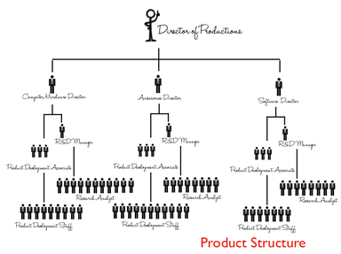
To Educate the church as to how the programme of the church is financed.
Local church
Conference
Union
Division
General Conference

Slide 5
To Educate the church on the doctrine of spiritual gifts and its complementing ministries

Slide 6
To Educate the church about the benefits and blessings of faithfulness to God in tithes and offerings.

Slide 7
To help families to develop a workable financial plan to serve their particular purpose.

Slide 8
To help individual members to develop a personal financial plan to serve each unique situation.

Slide 9
To inform the church about opportunities available for self-development which can be of benefit to all.

Slide 10
To be aware of the employment status of each member of the church family.

Slide 11
To know the level of faithfulness of each member of the church family.

Slide 12
To work closely with the pastor and the church board to always keep the issue of stewardship before the church family.

Slide 13
To compliment and encourage total honesty to God in the areas of Christian stewardship.

Slide 14
To contact the Stewardship department of the Conference to be aware of upcoming programmes (Week of Emphasis, Promotional activities, Workshops etc.)

Slide 15
To work closely with the Finance committee to plan the annual budget of the church.

Slide 16
To work together with the Finance committee/church board to review the church budget on an intermittent basis. (once per quarter is suggested)

Slide 17
To represent the Stewardship department on the church board

Slide 18
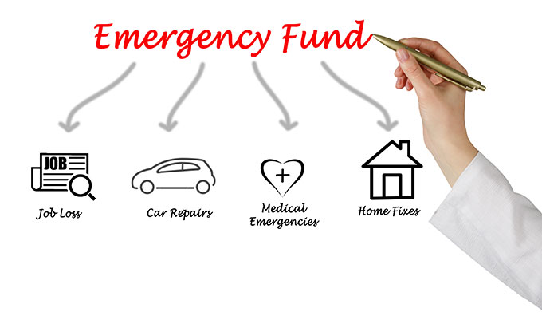
To aggressively promote the Caribbean Union revolving fund.

Slide 19
To serve as a good spiritual leader.

Slide 20
To be a good example of a faithful steward.

Slide 21
To understand and teach with conviction the principles of Christian stewardship.

Slide 22
To know and identify with the spiritual and financial program of the church.

Slide 23
To dedicate time to plan, organize, and lead out in designated areas of responsibility in co-operation with the Conference stewardship director, the pastor and the church board.

Slide 24
To be a member of the church board.

Slide 25
To serve as member of the stewardship and financial committee of the local church.

Slide 26
To educate the church by means of the material provided for ten minutes feature and sermons-power point presentations.

Slide 27
To submit to the conference/stewardship director and the pastor a quarterly stewardship report.

Slide 28
To educate members in the areas of estate planning (making of a will)

Slide 29
To compile a vocational skills directory (local yellow pages) of members.

Slide 30
To support the pastor in the promotion of systematic benevolence 60-20-20.

